Slide 1
Amateur Radio Trivia
  A few things you probably didn’t know about amateur radio & radio amateurs

Slide 2
Warning!
You will not learn anything of use from this presentation!!!

Slide 3
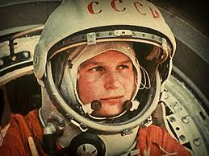
Was Yuri Gagarin a radio amateur?

Slide 4
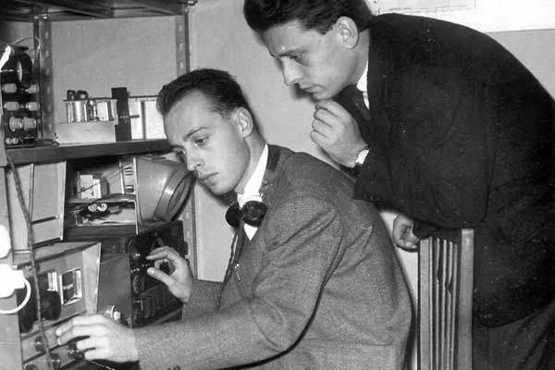
Lost Cosmonauts Conspiracy Theory
Judica-Cordiglia Brothers

Slide 5
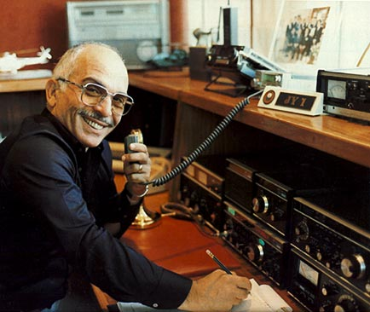
Amateur Radio Royalty
King Hussein of Jordan (JY1) sk

Slide 6
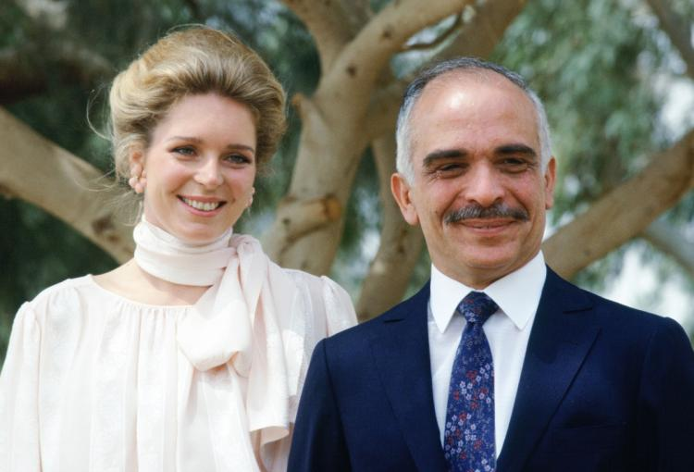
Amateur Radio Royalty
Queen Noor of Jordan (JY1NH)

Slide 7
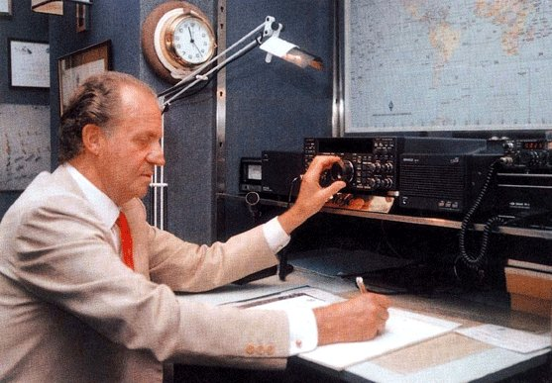
Ex-King Juan Carlos of Spain (EA0JC)

Slide 8
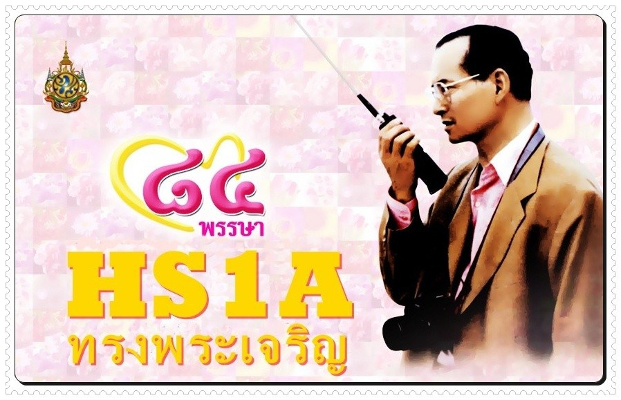
King of Thailand (HS1A) sk

Slide 9
More Amateur Radio Royalty
Oaboos Bin Asid Al Asid (A41AA): Sultan of Oman
King Hassan II of Morocco: (CN8MH) SK
Sheikh Hamed Bin Khalifa Al Thani (A71AP): Amir of Qatar
Sheikh Hamed Bin Isa Al Khalifa (A92AK): Amir of Bahrain
Prince Tunku A. Rahman (9M2TR): Prince of Johor, Malaysia
Prince Alberto Grimaldi (3A0AG): Prince of Monaco

Slide 10
Countries where it is hard/impossible to get an amateur radio licence
No licences issued
  North Korea
  Yemen
Club station only – no individual licences
  Vatican City

Slide 11
Numbers of amateur radio licenses in the UK (Ofcom)
Licence Type | Date of Statistics | No. of licences
Club | November 2016 | 1478
Foundation | August 2017 | 22649
Full | August 2017 | 52195
Intermediate | August 2017 | 9739
Reciprocal | June 2016 | 803

Slide 12
Top 12 counties by amateur radio population
Rank | Country | Population
1 | Japan | 1296059
2 | USA | 679864
3 | Thailand | 141241
4 | RO Korea | 141000
5 | Germany | 79666
6 | Chinese Taipei | 68692
7 | Spain | 58700
8 | UK | 58426
9 | Canada | 44024
10 | Russia | 38000
11 | Brazil | 32053
12 | Italy | 30000

Slide 13
The next 12 countries by amateur radio population
Rank | Country | Population
13 | Indonesia | 27815
14 | France | 18500
15 | Ukraine | 17265
16 | Argentina | 16889
17 | Poland | 16000
18 | Australia | 15328
19 | Netherlands | 14529
20 | Sweden | 10817
21 | India | 10679
22 | Venezuela | 10600
23 | Denmark | 10060
24 | Hungary | 9000

Slide 14
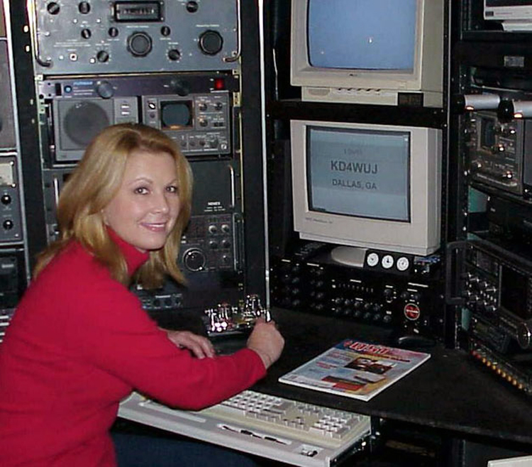
Musical Radio Amateurs
Patty Loveless (KD4WUJ)

Slide 15
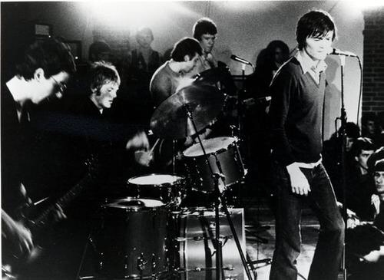
Musical Radio Amateurs
Feargal Sharkey (G0OAN) The Undertones

Slide 16
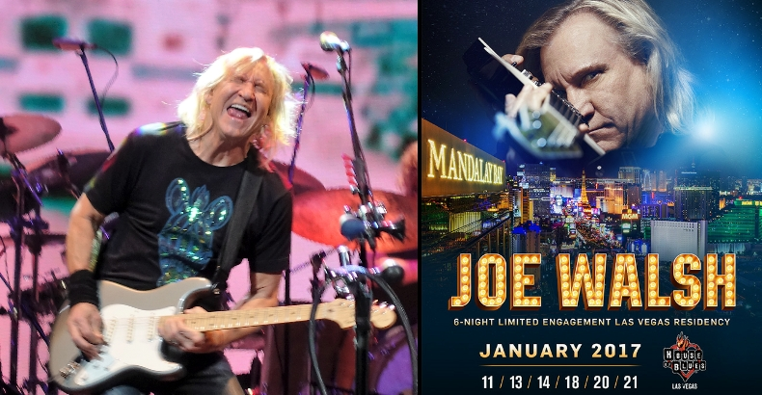
Musical Radio Amateurs
Joe Walsh (WB6ACU)

Slide 17
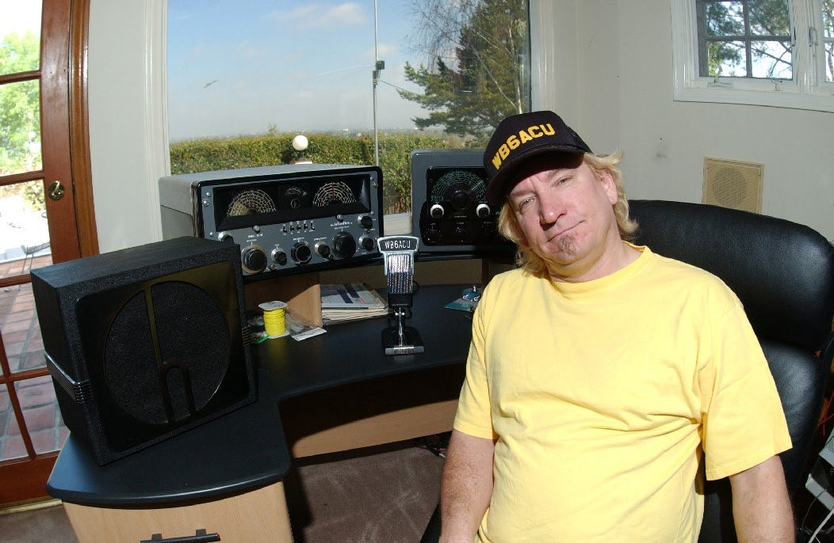
Musical Radio Amateurs
Joe Walsh (WB6ACU)

Slide 18
Other Musical Radio Amateurs
Leo Fender (W6DOE) sk: Fender guitars
Bob Moog (K2AMH) sk: Moog Synthesizer
Jim Croce (WN3OQW) sk: Folk/rock singer/songwriter
Lance Bass (KG4UYY): ‘N SYNC (US boy band)
Chet Atkins (W4CGP, ex-WA4CZD) sk: Singer/
songwriter/guitarist
Stu Cook (N6FUP): Creedence Clearwater Revival
Ronnie Milsap (WB4KCG): Singer/Songwriter
Burl Ives (KA6HVA) sk: Folk music singer/writer/actor

Slide 19
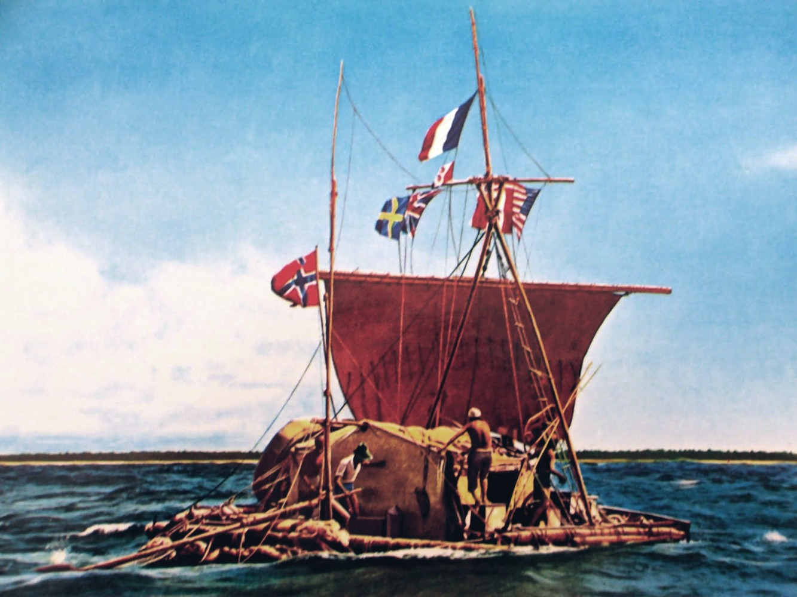
Kon-Tiki Expedition 1947
(LI2B)

Slide 20
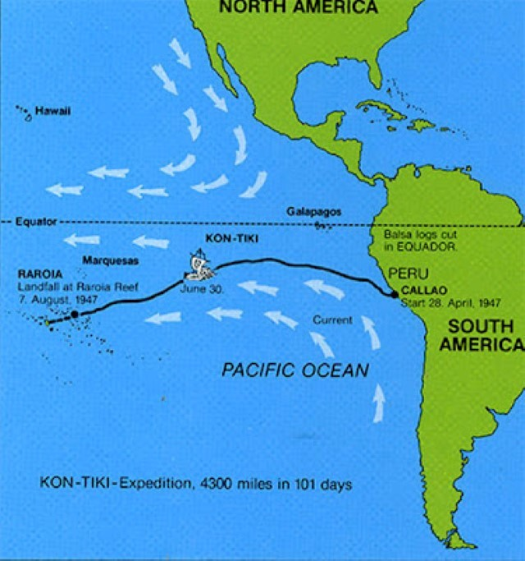
Kon-Tiki Expedition 1947
Route

Slide 21
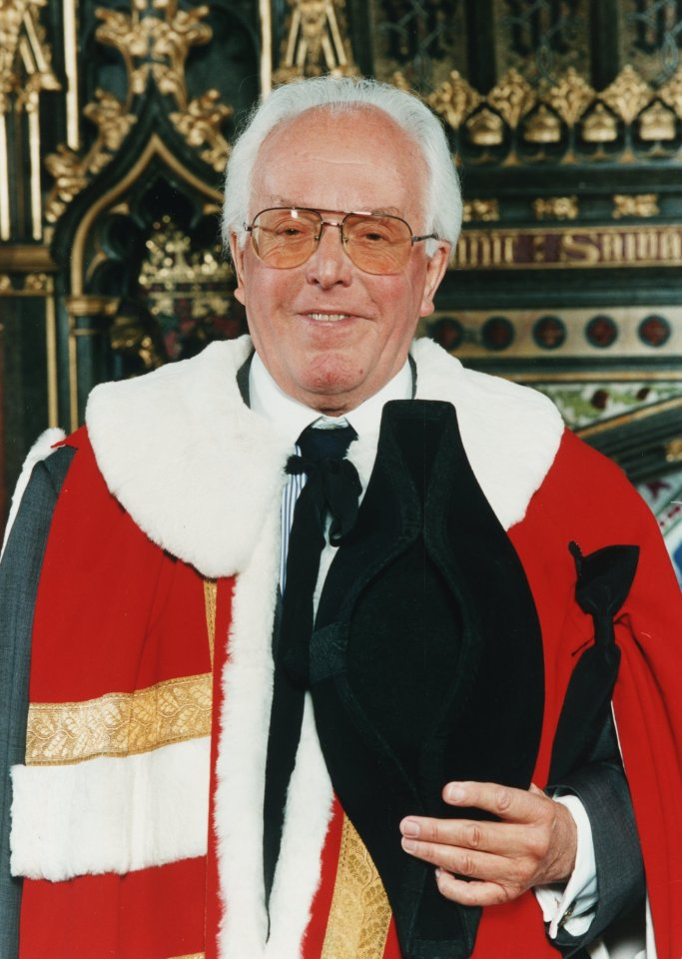
Radio amateurs who were/are actors
Lord Brian Rix (G2DQU) sk

Slide 22
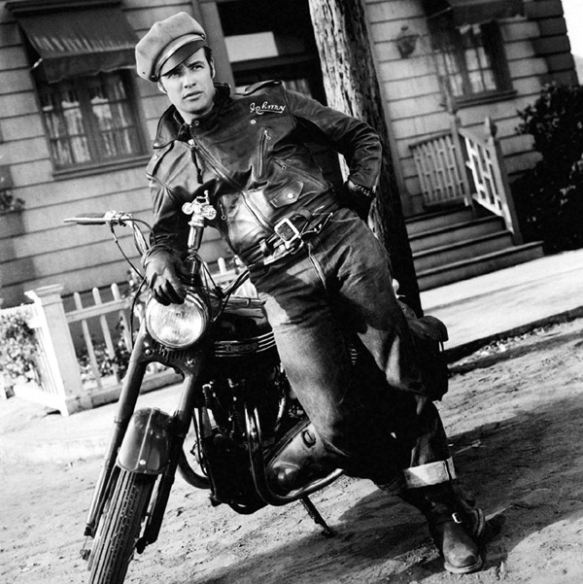
Radio amateurs who were/are actors
Marlon Brando (KE6PZH/FO5GJ) sk

Slide 23
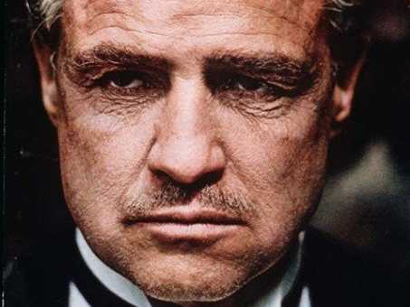
Radio amateurs who were/are actors
Marlon Brando (KE6PZH/FO5GJ) sk

Slide 24
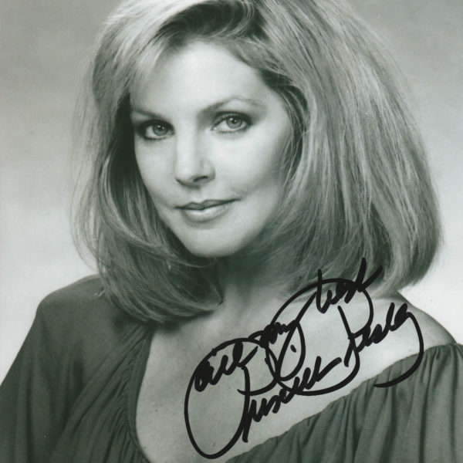
Radio amateurs who were/are actors Priscilla Presley (N6YOS)

Slide 25
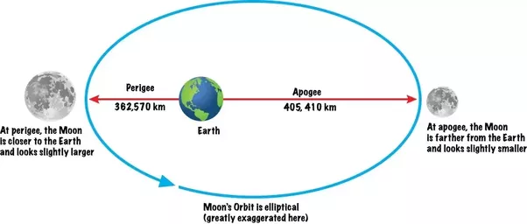
Moonbounce: Variation in time taken for radio signal to return

Slide 26
Moonbounce: Variation in time taken for radio signal to return
Apogee: 405,410km
Perigee: 362,570km
Difference: 42,840km
Radio signal travels an extra 85,680km i.e. there & back
Radio signals travel at 299,792km/second
Difference in time taken is: 85,680/299,792 seconds = 0.285 seconds

Slide 27
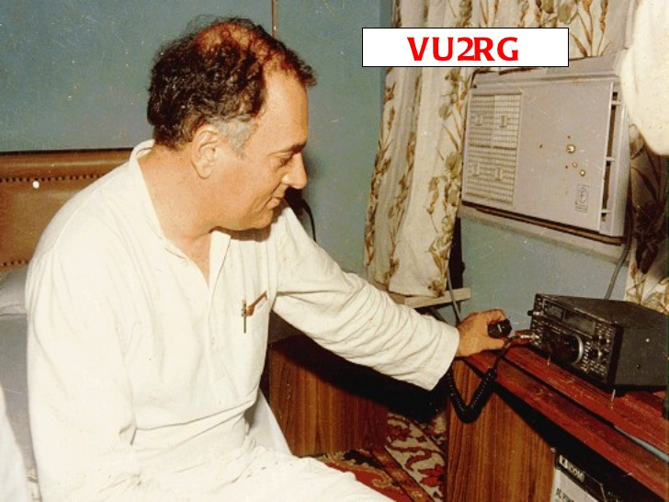
Radio amateurs who were/are politicians
Rajiv Ghandi (VU2RG) sk

Slide 28
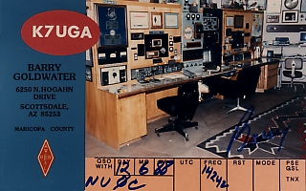
Radio amateurs who were/are politicians
Barry Goldwater (K7UGA) sk

Slide 29
Radio amateurs who were/are politicians
General Augusto Pinochet (CE3GP): President of Chile
Hugo Banzer (CP1CL): President of Bolivia
Francego Cossiga (I0FCG): President of Italy
Keizo Obuchi (JI1KIT): Prime Minister of Japan
Carlos Saul Menem (LU1SM): President of Argentina
Emil Lahoud (OD5LE): President of Lebanon
Sonia Ghandi (VU2SON): Widow of Rajiv Ghandi
Sir Thomas Davis (ZK1AN): Premier of the Cook Islands

Slide 30
3 streets on Holderness Road that are named after radio pioneers
Faraday Street: Michael Faraday (1791-1867)
Main discoveries include the principles underlying electromagnetic induction, diamagnetism & electrolysis
Kelvin Street: William Thomson, The Lord Kelvin (1824-1907)
Mathematical analysis of electricity & formulation of the first & second laws of thermodynamics
Lodge Street: Oliver Lodge (1851-1940)
Identified electromagnetic radiation & held key patents relating to radio

Slide 31
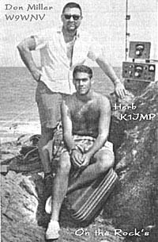
Radio amateurs who ended up in jail for a long time! Don Miller (W9WNV/AE6IY): Over 20 years

Slide 32
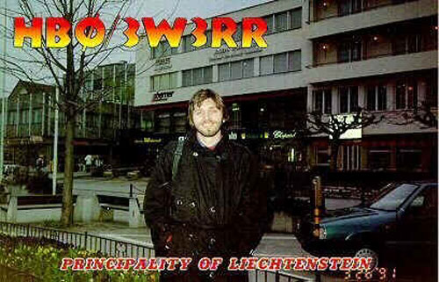
Radio amateurs who ended up in jail for a long time! Romeo Stepanenko (UB5RR, P5RS7, etc.): 18 years

Slide 33
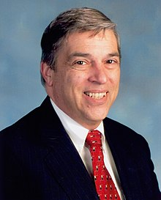
Radio amateurs who ended up in jail for a long time!
Robert Hanssen (K9QVL): 15 consecutive life sentences with no chance of parole

Slide 34
Films where amateur radio/amateur radio equipment was featured
Andy Hardy (1938)
  Man in USA gets an urgent message to his wife in Canada via
  amateur radio as the place in Canada has no phones
Testament (1983)
  Nuclear war – radio amateur provides some communications
Independence Day (1996)
  Morse code used for communications – humans defeat the aliens!
Independence Day: Resurgence (2016)
  Yaesu FT-101 used for communications – aliens defeated again!
Frequency (2000)
  Heathkit transceiver used for communications between son & his
  deceased father via a time warp caused by the Northern Lights

Slide 35
Films where amateur radio/amateur radio equipment was featured
Si tout les gars du monde (1955): French
  French trawler crew in the North Sea become ill & radio amateurs help in
  getting an antidote to them
Ghost House (mid-1980s)
  Too complicated to explain but amateur radio is definitely in there
Phenomenon (1996)
  Radio amateur finds some encrypted transmissions that he gets decoded
  and then gets into trouble with the government.
Contact (1997)
  Amateur radio operator controls the Very Large Array in New Mexico,
  where she picks up an extraterrestrial signal
High Frequency (1989)
  Spy plot resolved using amateur radio
Dr. No (1962)
    KW Vanguard transmitter & Eddystone receiver used

Slide 36
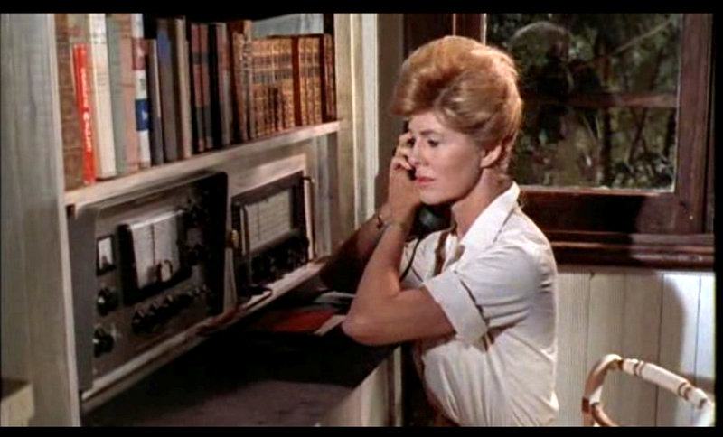
Dr. No

Slide 37
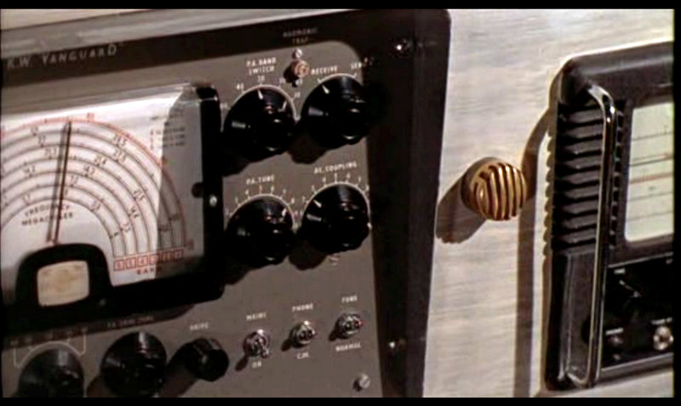
Dr. No

Slide 38
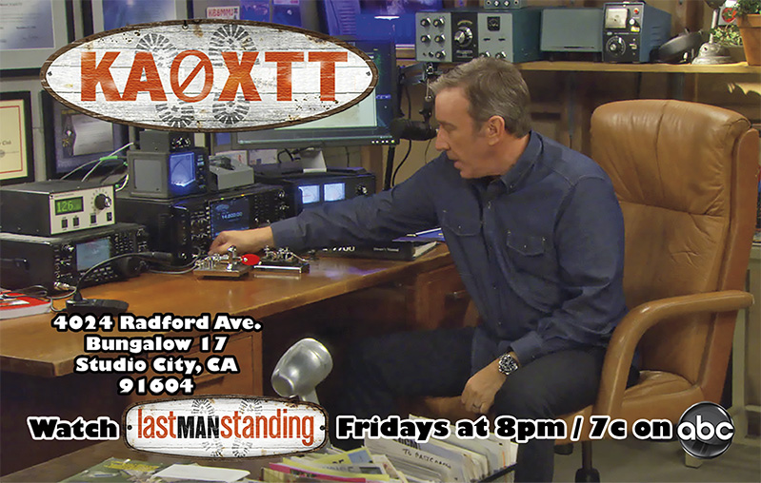
Tim Allen as Mike Baxter (KA0XTT)

Slide 39
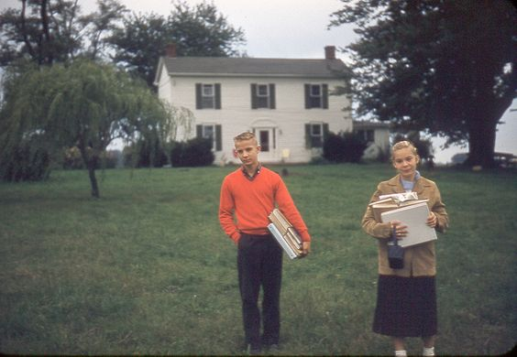
Radio amateurs with other claims to fame
Peggy Sue Rackham (K5PSG)

Slide 40
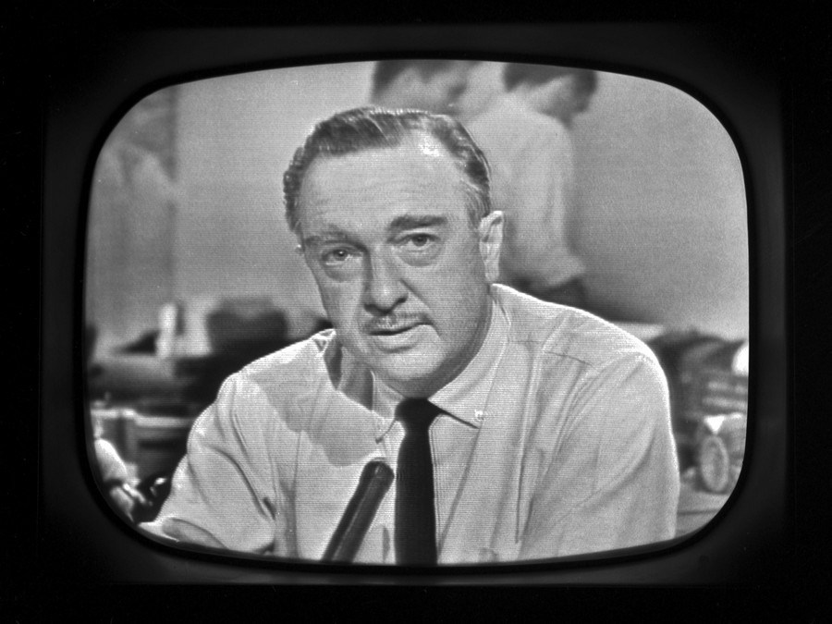
Radio amateurs with other claims to fame
Walter Cronkite (KB2GSD) sk

Slide 41
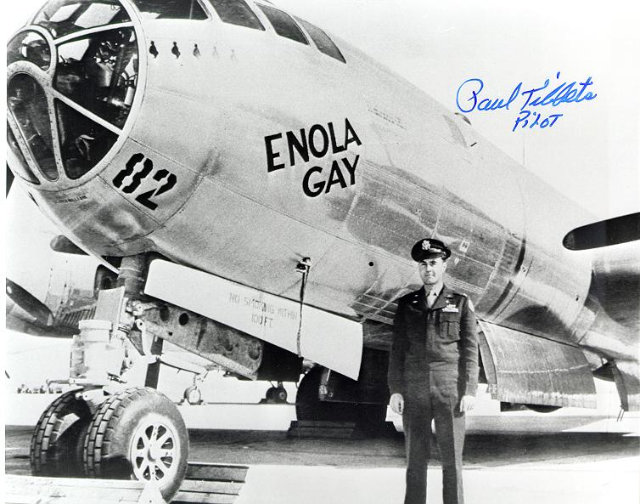
Radio amateurs with other claims to fame
Paul Tibbets (K4ZVZ) sk: Pilot of the “Enola Gay”

Slide 42
Radio amateurs with other claims to fame
D. Kent Cullers (WA6TWX): Former Manager of SETI
Dr. Joseph H. Taylor (K1JT) & Russell Alan Hulse (WB2LAV): Joint winners of 1993 Nobel Prize for Physics for discovery of binary pulsars
Percy L. Spencer (W1GBE) sk: Invented the microwave oven
Yuri Ivanovich Malenchenko (RK3DUP): First cosmonaut to marry in space
Howard Hughes (W5CY) sk: Billionaire businessman
Chris Tarrant (G0KRH): TV personality

Slide 43
Some amateur radio firsts
1900: Reginald Aubrey Fessenden (1XS): First broadcast of human speech
1927: Barbara Dunn (G6YL): First UK lady amateur
1928: John Logie Baird (2KZ) & Robert Hart (2CVJ): First transatlantic TV image broadcast
1947: Oswald Garrison (W6YX) & Mike Villard jnr (W0TQK): First SSB QSO
1983: Owen Garriott (W5LFL): First radio amateur to broadcast from space – Space Shuttle mission STS-9

Slide 44
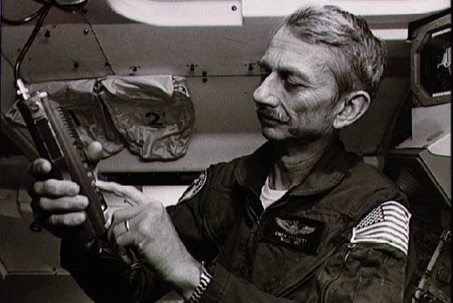
1983: Owen Garriott (W5LFL): First radio amateur to broadcast from space – Space Shuttle mission STS-9

Slide 45
Amateur Radio Clubs With Claims To Fame
Manchester Wireless Society (2FZ & 5MS): Britain’s oldest radio club – founded in February 1911
Coventry ARS (GX2ASF): Club that has longest affiliation to RSGB – from 1935

Slide 46
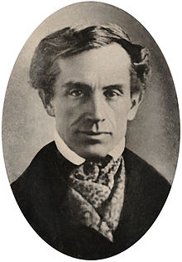
Samuel Morse (1791-1872)

Slide 47
Samuel Morse
Summary of Life Events
Full name: Samuel Finley Breese Morse
Born: 27 April 1791, Charlestown, Massachusetts
Education: Phillips Academy, Yale College, Royal Academy of Arts
Family: 2 wives (first died) & 7 children
Original occupation: Portrait artist
Politics: Anti-Catholic, anti-immigration, defended slavery
1832-1850s: Telegraph, Morse Code, transatlantic cable
Death: 2 April 1872, New York City

Slide 48
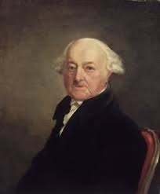
Samuel Morse
John Adams, Second President of the USA, 1816

Slide 49
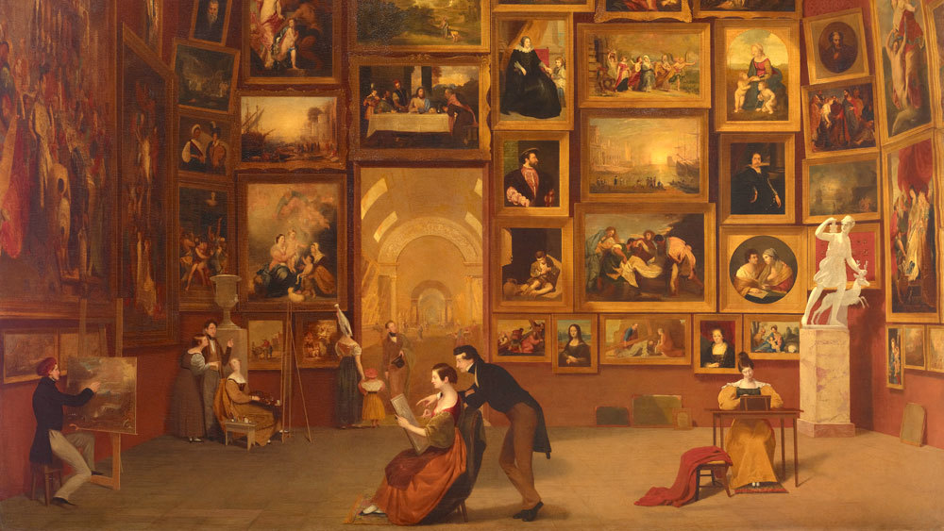
Samuel Morse
The Gallery of the Louvre, 1831-1833

Slide 50
Some companies that used to produce equipment for radio amateurs
Collins
Drake
Eddystone
EF Johnson
EICO
Hallicrafters
Hammarlund
Heathkit (still active)
KW Electronics
Lafayette
Lowe Electronics
Marconi
Mullard
National
Signal/One
Swan
WRL

Slide 51
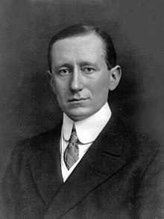
Guglielmo Marconi (1874-1937)

Slide 52
What do you know about Marconi?
Full name: Guglielmo Giovanni Maria Marconi
Birth: 25 April 1874 at Palazzo Marescalchi, Bologna, Italy
Studied: University of Bologna
Nobel Prize: 1909 Physics with Karl Braun for work in radio communications
Honours: 1929 made a marquess by King Victor Emmanuel III
Politics: Fascist
Death: 20 July 1937 in Rome, Italy after series of heart attacks
Burial: Villa Griffone, Sasso Marconi, Emilia-Romagna. IY4FGM (formerly I0FGM & II4FGM) is located there.
Named after him: 1. Asteroid 1332 Marconia. 2. A large crater on the far side of the Moon. 3. Bologna Guglielmo Marconi Airport, Bologna. 4. Open University Guglielmo Marconi in Rome.

Slide 53
IOTA: 12 of the most wanted island groups
Group Name | Main Prefix | Notes
Erongo / Hardap Region group | V5 | Namibia
Nyanga Province group | TR | Gabon
Cote d'Ivoire group | TU | Cote d'Ivoire
Namibe Province group | D2 | Angola (2)
Red Sea Cost South group | SU | Egypt
Liberia group | EL | Liberia
Mediterranean Sea Coast East group | 5A | Libya
Halaib Triangle group | ST | Sudan (2)
Gulf of Aden West Group | T5 | Somalia (2)
Balleny Islands | Various | Antarctica – claimed by NZ
Scott Island | Various | Antarctica – no claim
Shag Rocks | VP8 | South Georgia

Slide 54
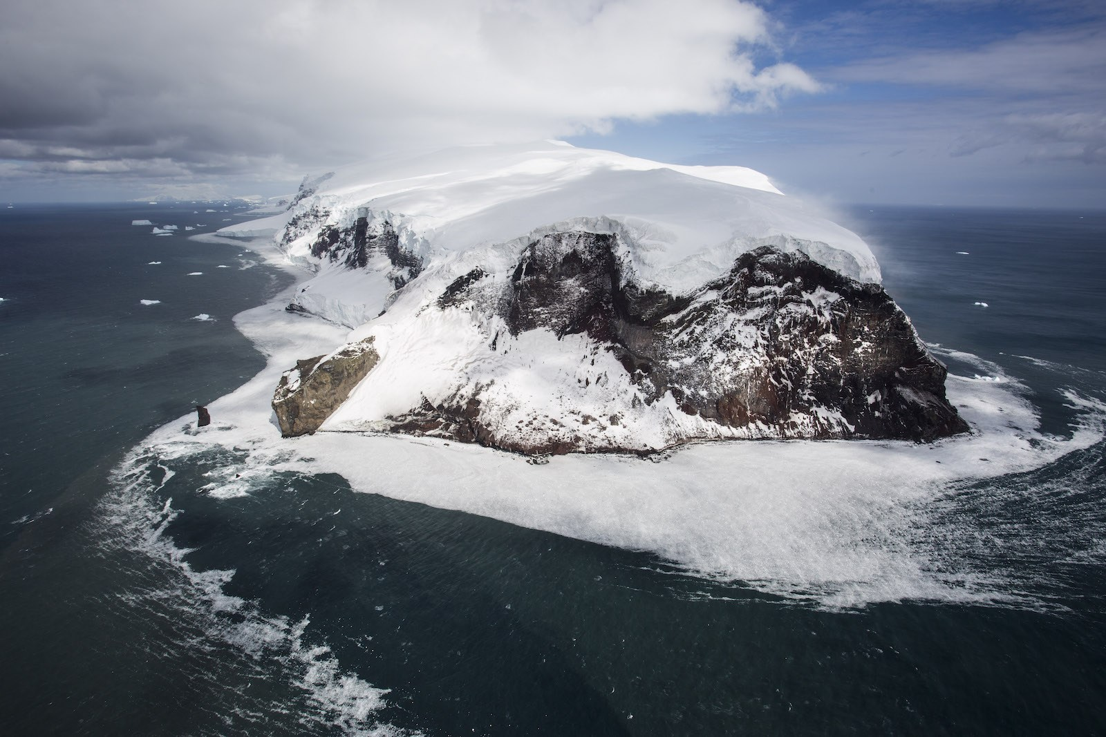
Balleny Islands, Antarctica

Slide 55
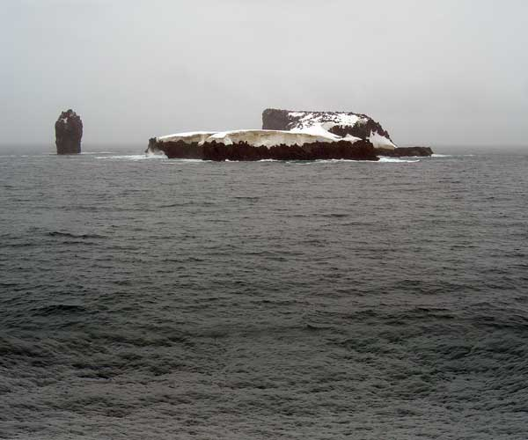
Scott Island, Antarctica

Slide 56
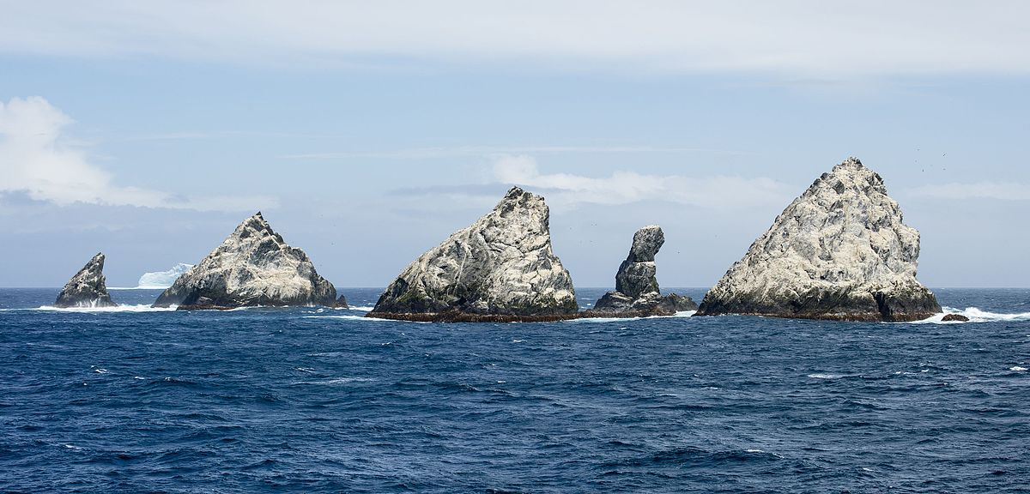
Shag Rocks, South Georgia

Slide 57
IOTA: Another 12 most wanted island groups
Group Name | Main Prefix | Notes
Gujarat State East group | VU | India (3)
Balochistan Province group | AP | Pakistan (2)
Mon Region group | XZ | Myanmar (3)
Gulf of Aden East group | 7O | Yemen
Khuzestan Province group | EP | Iran (2)
Senkaku Islands | JA6 | Japan
Kangwon-do Province group | P5 | North Korea (4)
Marias Islands | XE | Mexico
Bounty Islands | ZL9 | New Zealand
Nihoa Is., Necker Is., Gardner Pinnacles, Laysan Is., Lisianski Is., Pearl & Hermes Atoll | KH6/KH7 | NW Hawaiian Islands, USA
Mediterranean Sea Coast group | CN | Morocco
Arica y Parinacota/Tarapaca Region group | CE1 | Chile

Slide 58
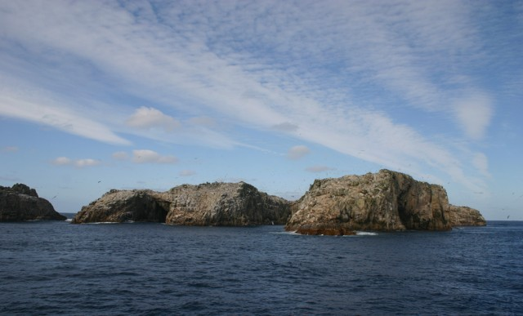
Bounty Islands, New Zealand

Slide 59
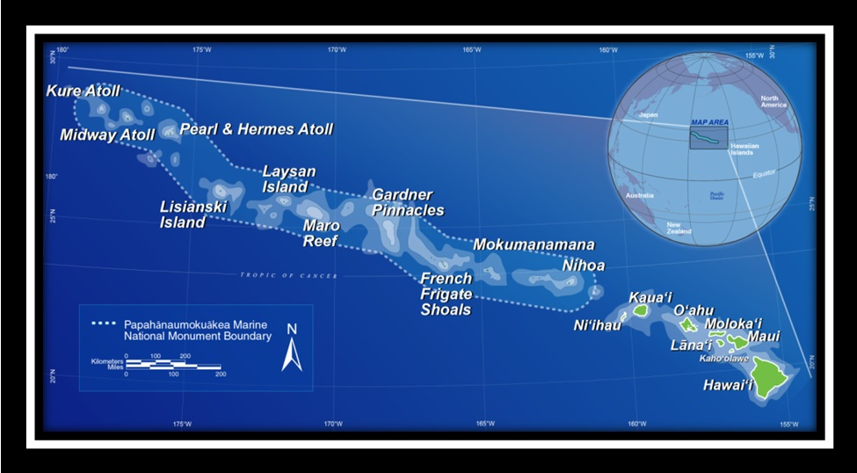
Northwestern Hawaiian Islands

Slide 60
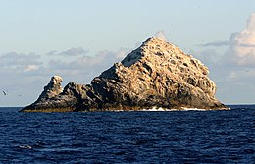
Gardner Pinnacles

Slide 61
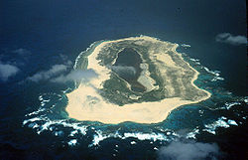
Laysan Island

Slide 62
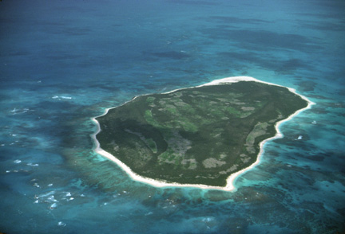
Lisianski Island

Slide 63
First radio amateur in Hull?
Source: Gamages 1914 directory of experimental wireless stations in the UK
Charles Dyson
Callsign: OXO
68 Marshall Street, Newland Avenue, Hull
Usual operating times: Sundays 10-12

Slide 64
Shops that sold amateur radio equipment in Hull
Short Wave (Hull) Radio
  30-32 Princes Avenue
  Hull
  See SWM August 1947 & September 1962
Fanthorpe & Co.
  Hepworth Arcade
  Silver Street
  Hull
  See Bulletin January 1951
Peter Seymour
  410 Beverley Road
  Hull
  See SWM September 1962
RSC
  Paragon Street
  Hull

Slide 65
Sovereign Military Order of Malta
The most unusual amateur radio “country”?
Sovereign Military Hospitaller Order of St. John of Jerusalem, of Rhodes & of Malta
Founded c1099 in Jerusalem by the Blessed Gerard
Links to the Knights Hospitaller founded c1048 to provide medical care to pilgrims to the Holy Land
After the fall of Jerusalem in 1099 became a military order to protect Christians from Islamic persecution
Papal recognition of sovereignty by Pope Paschal II (1113)
HQs: Cyprus (1291-1310), Rhodes (1310-1523), Malta (1530-1798), Rome (1834-Present)
Religious affiliation: Roman Catholic

Slide 66
Sovereign Military Order of Malta
The most unusual amateur radio “country”?
2 HQ buildings in Rome classed as “extraterritorial” (similar status to embassies)
Diplomatic relations with 107 countries
Over 13,500 Knights, Dames & aux. Members
Employs 25,000 doctors, nurses, auxiliaries & paramedics helped by 80,000 volunteers in over 120 countries
Helps children, homeless, handicapped, refugees, elders, terminally ill & lepers around the world without distinction of ethnicity or religion
Annual budget c200 million Euros mainly funded by European governments, the UN & the EU
Permanent observer status at the UN granted 24/8/1994
Amateur radio prefix 1A0

Slide 67
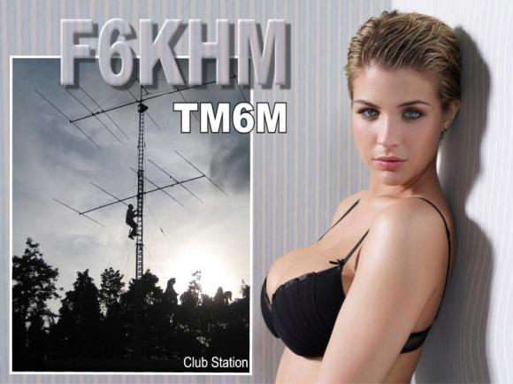
TM6M QSL card (and it is real!)

Slide 68
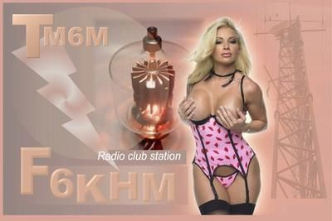
And another F6KHM QSL card!

Slide 69
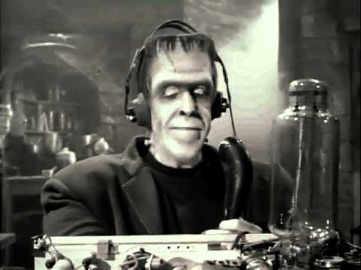
And just when you thought you’d seen everything! (W6XRL4)

