Slide 1
Amateur Radio Trivia 2
  More things you probably didn’t know about amateur radio & radio amateurs

Slide 2
Warning!
Once again - you will not learn anything of use from this presentation!!!

Slide 3
Famous places that hold amateur radio callsigns
ARRL HQ, Newington, Connecticut: W1AW
BBC Radio Club, Daventry: G2LO
Bletchley Park: GB2BP
Ealing Film Studios: G3BBC
Foundation Guglielmo Marconi (Villa Griffone, Marconi’s house) II4FGM & IY4FGM (formerly I0FGM):
Indianapolis Motor Speedway: W9IMS
ISS: Russian - RS0ISS, USA – NA1SS,
European – DP0ISS, OR4ISS, IR0ISS
Johnson Space Center, Houston: W5RRR
Kennedy Space Center, Cape Canaveral: N1KSC
Marconi Radio Society, Writtle: G2MT
RMS Queen Mary, Long Beach: W6RO
United Nations, Geneva: 4U1ITU
United Nations, New York: 4U1UN

Slide 4
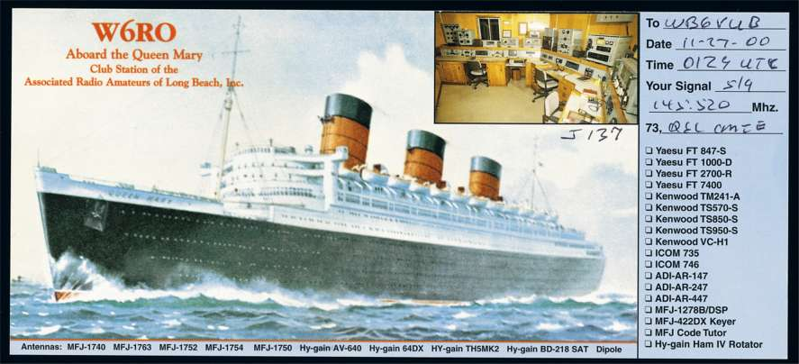
RMS Queen Mary (W6RO) QSL Card

Slide 5
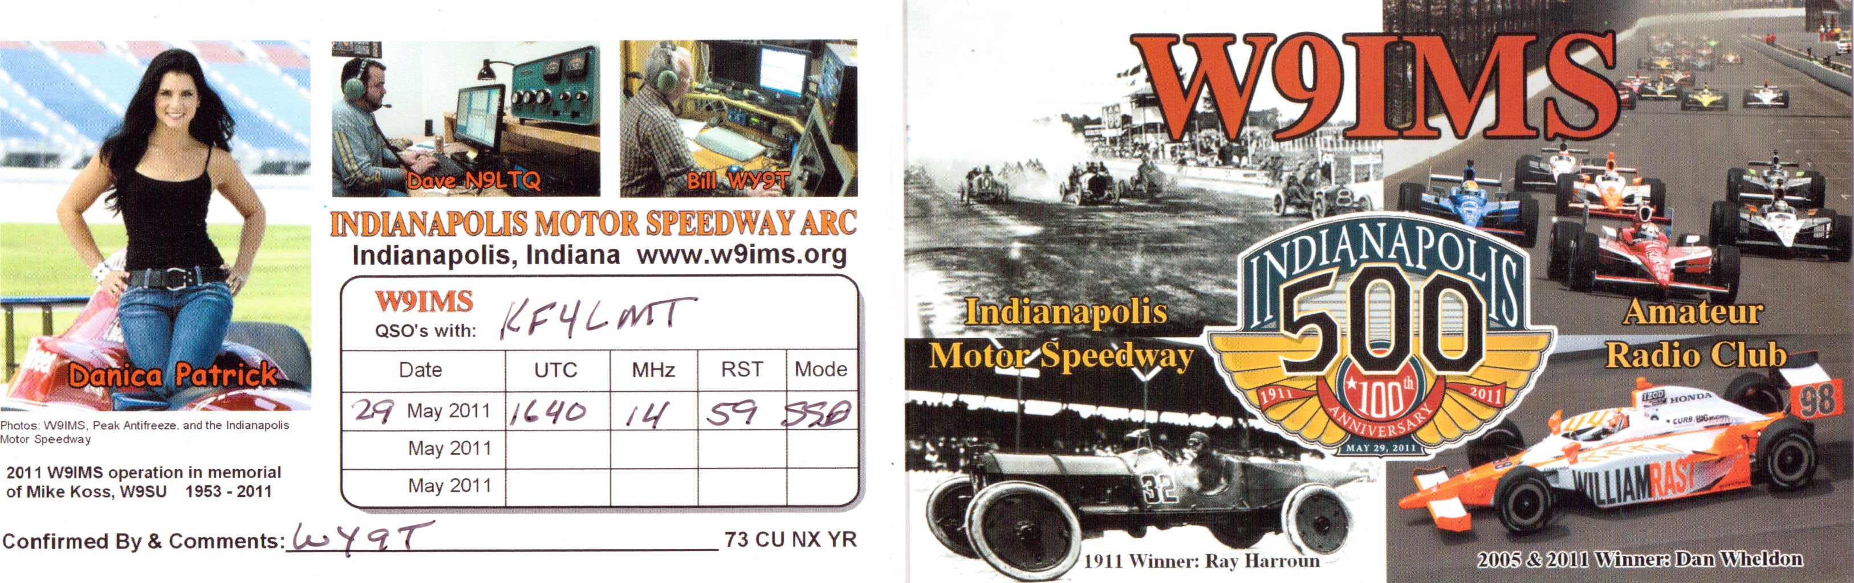
Indianapolis Motor Speedway ARC (W9IMS)
QSL Card

Slide 6
Amateur Radio Magazines
73
Amateur Wireless
CQ
DX Magazine
Ham Radio
Popular Wireless
Practical Wireless
QST
Radio Amateur News
Radio Craft
RSGB Bulletin/RadCom
Short Wave Listener
Short Wave Magazine/Radio User
Wireless Age
Wireless World

Slide 7
Standard Electrical Units Named After Scientists & Engineers
Electrical Parameter | Measuring Unit | Symbol | Named After
Voltage | Volt | V or E | Alessandro Volta (1745-1827) Italian Physicist, chemist, elec. & power pioneer
Current | Ampere | I or i | Andre-Marie Ampere (1775-1836) French Mathematician, physicist, electrodynamics pioneer
Resistance | Ohm | R or Ω | Georg Simon Ohm (1789-1854) German Physicist (electricity)
Conductance | Siemens | S | Ernst Werner von Siemens (1816-1892) German Inventor, industrialist
Capacitance | Farad | F | Michael Faraday (1791-1867) British Physicist, chemist

Slide 8
Standard Electrical Units Named After Scientists & Engineers
Electrical Parameter | Measuring Unit | Symbol | Named After
Charge | Coulomb | Q | Charles-Augustin de Coulomb (1736-1806) French Military engineer, physicist
Inductance | Henry | L or H | Joseph Henry (1797-1878) American Scientist (electromagnetism)
Power | Watts | W | James Watt (1736-1819) Scottish Inventor, mechanical engineer, chemist
Impedance | Ohm | Ω or Z | Georg Simon Ohm (1789-1854) German Physicist (electricity)
Frequency | Hertz | Hz | Heinrich Rudolf Hertz (1857-1894) German Physicist
Magnetic Flux Density | Tesla | T | Nikola Tesla (1856-1943) Austrian, American Inventor, electrical engineer, mechanical engineer, physicist, futurist

Slide 9
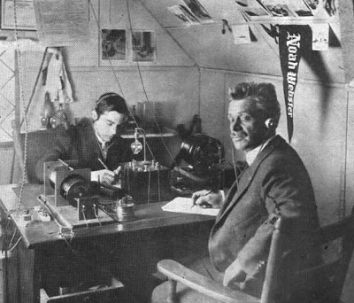
The Father Of Amateur Radio (according to the Americans)
Hiram P. Maxim (SNY, 1WH, 1AW, W1AW)

Slide 10
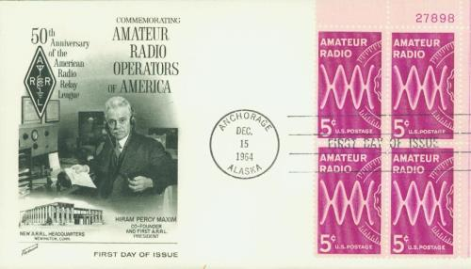
ARRL 1914-64 Celebration
First Day Cover

Slide 11
A Few Amateur Radio Firsts In The 1920s
1921: First US amateurs heard in UK
December 1922: First UK amateur heard in USA
27 November 1923: First transatlantic QSO - American Fred Schnell and Frenchman Léon Deloy
December 1923: First QSO between amateurs in London & West Hartford, Connecticut
1927-28: First International Radiotelegraph Conference in Washington, DC
  Standard amateur radio bands established: 80/75, 40, 20, 10
  Callsign prefixes established

Slide 12
First Modern DXpedition
Second weekend of 1948 ARRL International DX Contest
Leader: Bob Denniston (W4NNN)
“Gon-Waki” operation – name is spoof of Kon-Tiki expedition (1947)
VP7NG (Bahamas)
Denniston was ARRL President 1966-72

Slide 13
Gus Browning (W4BPD): Another Great DXpeditioner of the 1960s
Former Midwestern TV technician
Operated from over 100 locations including: Afghanistan (YA0H), Bouvet Is. (LH4C), Gambia (ZD3), Luxembourg (W4BPD/LX), Nepal (9N1MM), Rodrigues (VQ8), Tibet (AC4H), Tromelin Island (FR7)
1967: First inductee into CQ DX Hall of Fame
Taught himself to write left-handed for CW operation
World Radio Propagation Study Association (WRPSA)
Editor of the DX Magazine
Death: 21 August 1990 aged 82

Slide 14
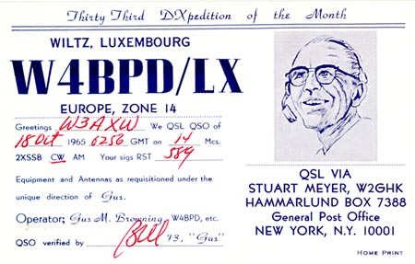
Gus Browning (W4BPD)
QSL from Luxembourg

Slide 15
Brits in the CQ DX Hall of Fame
Al J. Slater, G3FXB, April 1988
Nigel Cawthorne, G3TXF, May 2007
Roger Western, G3SXW, May 2007
Neville Cheadle, G3NUG, May 2009
Michael Wells, G7VJR May, 2015
Roger Balister, G3KMA May, 2016

Slide 16
A Few DXCC Deleted Entities
Name of Deleted Entity | Prefix(es) | New “Owner”
Aldabra Is. Desroches Is. Farquhar Is. | VQ9, VQ9---/A VQ9, VQ9---/D VQ9, VQ9---/F | Seychelles (S7)
Bajo Nuevo Serrana Bank & Roncador Cay | HK0 HK0, KS4 | San Andres & Providencia Is. (HK0)
Blenheim Reef | 3B | Chagos Is. (VQ9)
Panama Canal Zone | KZ5 | Panama (HO, HP)
French India | FN | India (VU)
French Indo-China | FI8 | Cambodia (XU), Laos (XW), Vietnam ( XV)
Geyser Reef | 1G | No longer entity for DXCC criteria
Goa | CR8 | India (VU)

Slide 17
A Few DXCC Deleted Entities
Name of Deleted Entity | Prefix(es) | New “Owner”
Kuwait/Saudi Arabia Neutral Zone | 8Z5, 9K3 | Area divided between the countries
Manchuria | C9 | China (BY)
Minerva Reef | 1M | Tonga (A3)
Netherlands Borneo | PK5 | Indonesia (JZ)
Netherlands New Guinea | JZ0 | Indonesia (JZ)
Palestine | ZC6, 4X1 | Israel (4X)
Saudi Arabia/Iraq Neutral Zone | 8Z4 | Area divided between the countries
Sikkim | AC3 | India (VU)
Tangier International Zone | CN2, EK1, KT1 | Morocco (CN)
Tibet | AC4 | China (BY)
Walvis Bay | ZS9 | Namibia (V5)

Slide 18
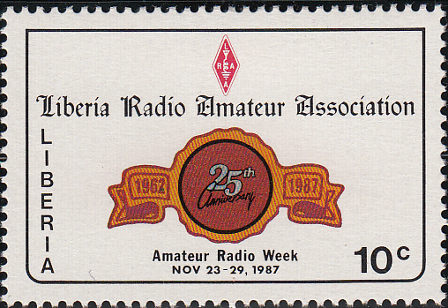
Stamp Commemorating Liberia Radio Amateur Association 1962-87

Slide 19
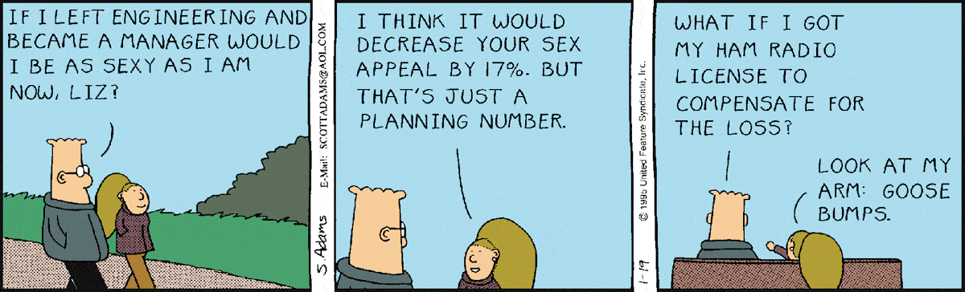
Dilbert & Amateur Radio

Slide 20
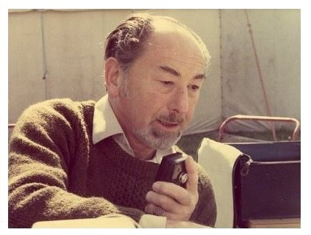
Louis Varney (G5RV)

Slide 21
A few facts about the International Amateur Radio Union (IARU)
Founded in 1925 in Paris
Its objectives are the protection, promotion, and advancement of the Amateur and Amateur-Satellite Services within the framework of regulations established by the International Telecommunication Union, and to provide support to Member-Societies in the pursuit of these objectives at the national level
Every country where amateur radio is legal & the amateurs have been able to organise themselves has representation at the IARU. So, for example, South Sudan doesn’t have representation due to civil war
World is divided into 3 regions made up of 75 zones

Slide 22
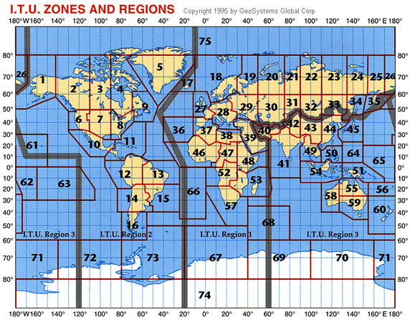
The IARU’s 3 Regions & 75 Zones

Slide 23
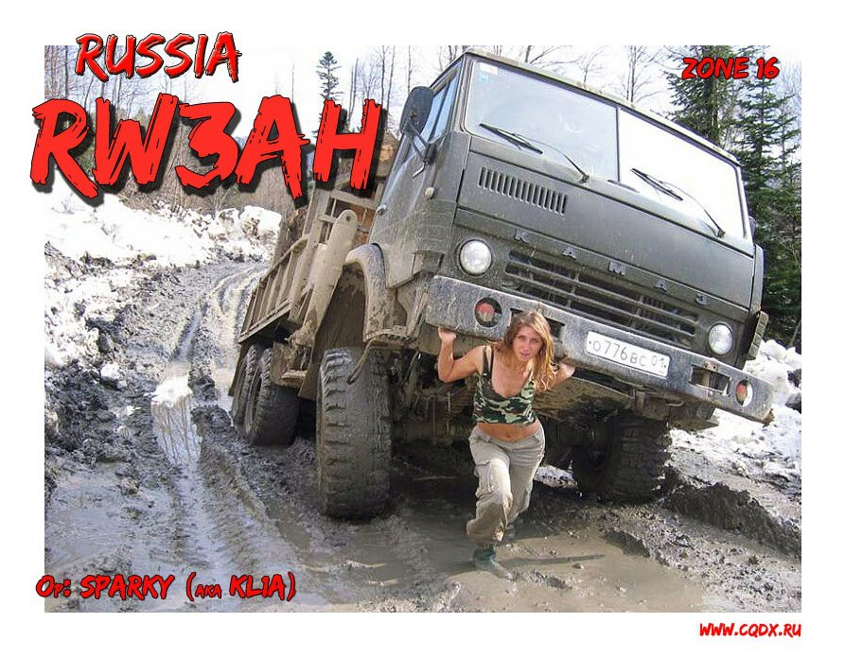
RW3AH QSL Card

Slide 24
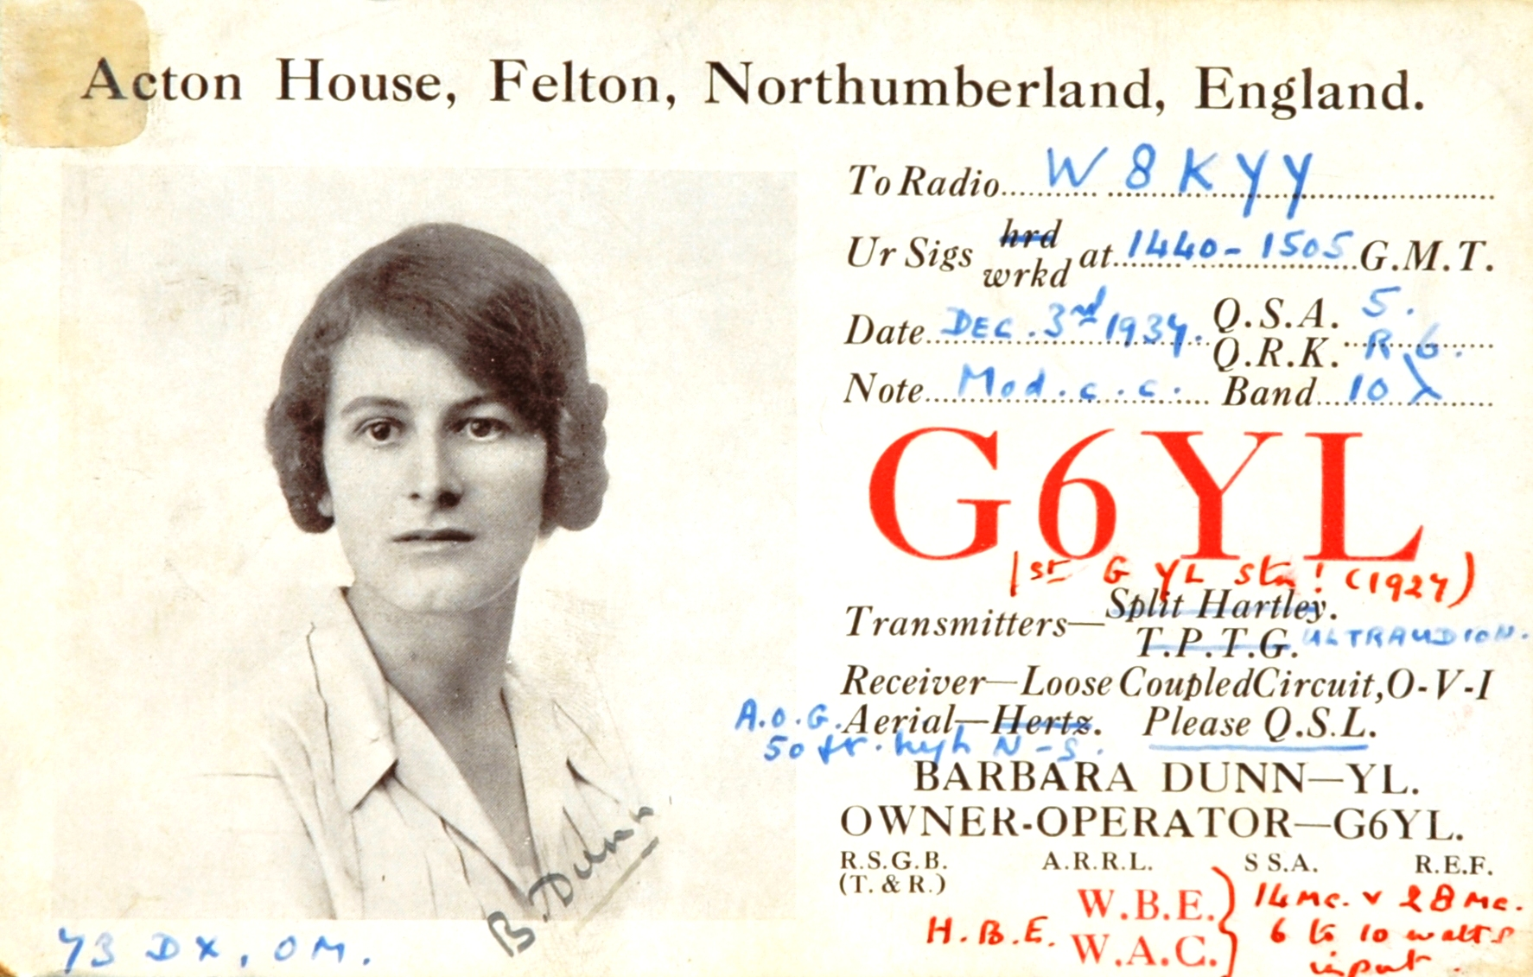
Barbara Dunn (G6YL)
First English YL Operator - 1927

Slide 25
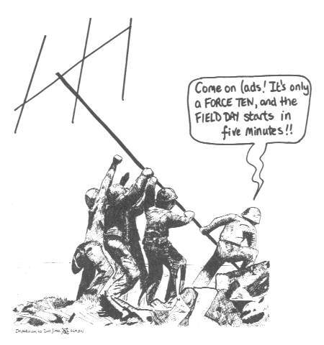
The Funny Side – Dedicated to Phil

Slide 26
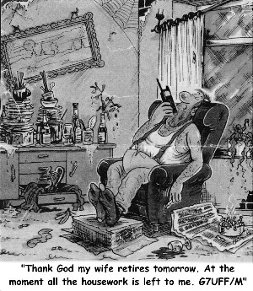
The Funny Side

Slide 27
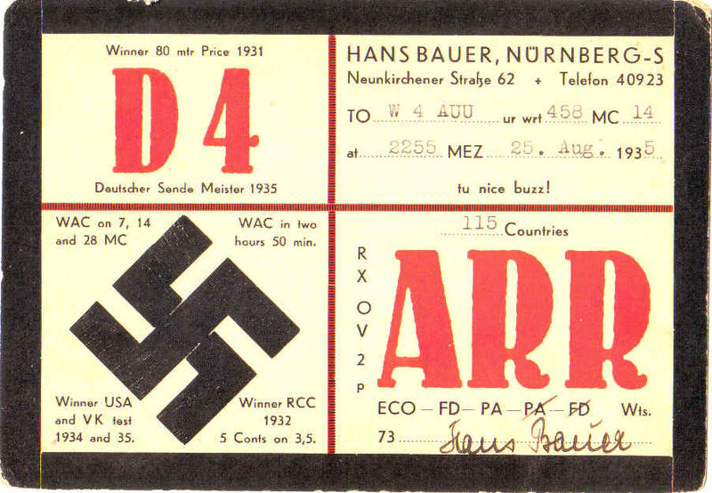
1935 German QSL Card

Slide 28
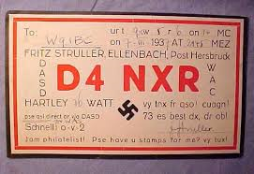
1937 German QSL Card

Slide 29
OSCAR 1
The First Amateur Radio Satellite
Launched on 12 December 1961 from Vandenberg Air Force Base, California
Launch vehicle: Thor DM-21 Agena-B rocket
Secondary payload to Discoverer 36, a military, optical reconnaissance satellite, that was the primary payload
No on-board propulsion so the satellite only orbited for 22 days
Over 570 amateurs based in 28 countries used the satellite for QSOs

Slide 30
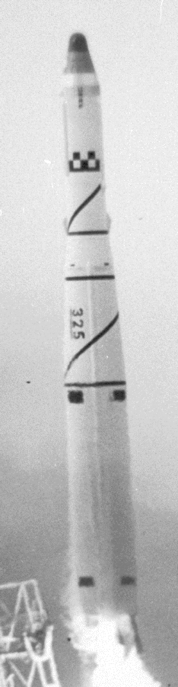
OSCAR 1Launch
Launch vehicle: Thor DM-21 Agena-B rocket

Slide 31
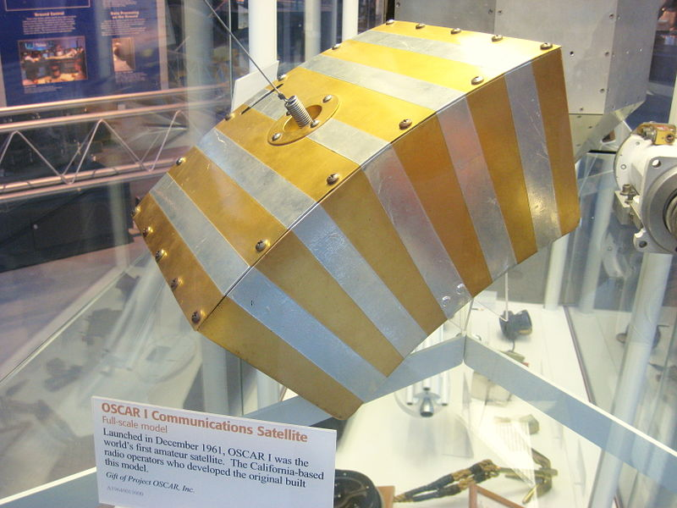
OSCAR 1 Model in the Steven F.
Udvar-Hazy Center, Chantilly, Virginia

Slide 32
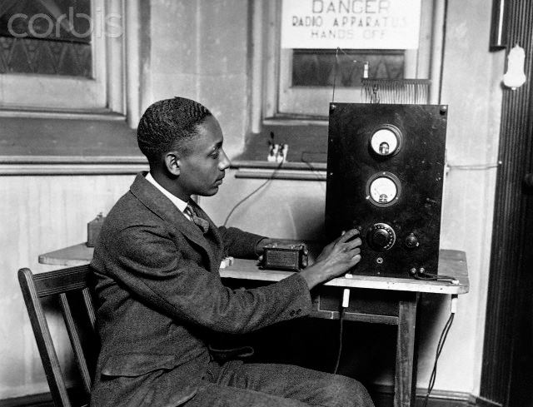
Rufus P. Turner (W3LF)
First Black Operator in the U.S. - 1926

Slide 33
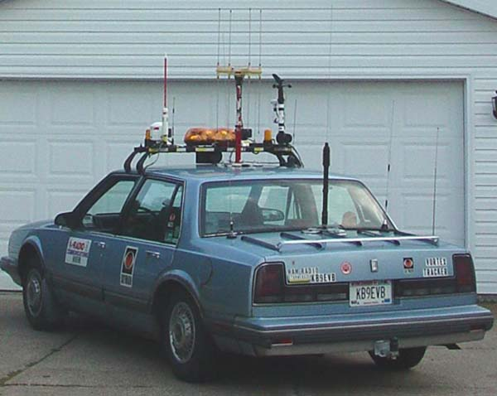
Going Over The Top – KB9EVB/M

Slide 34
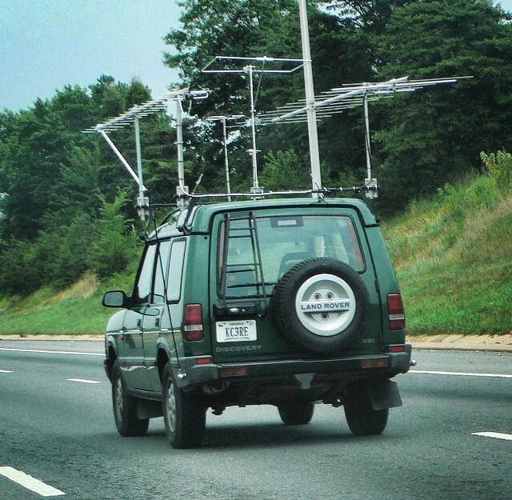
And another one! KC3RE

Slide 35
Why is a Yagi called a Yagi?
Full name is the Yagi-Uda antenna
Invented in 1926 by Shintaro Uda of Tohoku Imperial University, Japan &, with a lesser role, Hidetsugu Yagi
Yagi filed a patent for the idea in Japan but missed off Uda’s name!
The patent was later transferred to the Marconi Company in the UK

Slide 36
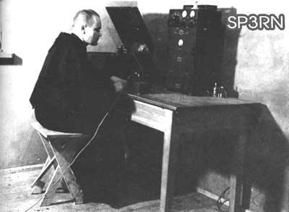
St. Maximilian Maria Kolbe (SP3RN)
Patron Saint of Amateur Radio

Slide 37
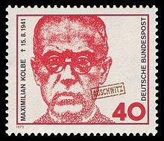
St. Maximilian Maria Kolbe
Commemorative Stamp

Slide 38
A Few Facts About Tony Hancock’s “The Radio Ham”
First transmitted by BBC on 9 June 1961
Written by Ray Galton & Alan Simpson
October 1961, Pye Records produced audio remake together with a remake of “The Blood Donor”
9 February 1996, Paul Merton starred in the Hancock role in a remake of the programme
The line “Would you stop playing with that radio of yours, I’m trying to get some sleep!” sampled at the end of George Michael’s 1992 single “Too Funky”

Slide 39
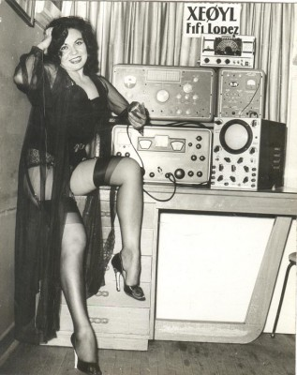
Fifi Lopez (XE0YL)

Slide 40
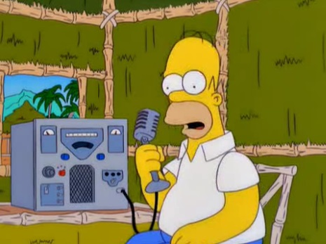
Homer Simpson (WA3QIZ)

Slide 41
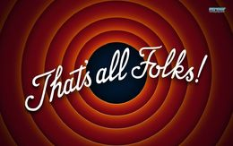
The End!

