Slide 1

The Don Miller Story
DXpedition Hero or Villain?

Slide 2
Presentation Overview
Why Don Miller?
Early life
Activity whilst in the US Army
1965 – 1967 DXpeditions
The end of Miller’s DXpeditions
Coming up to date
Is Miller a hero or a villain?

Slide 3
Miller’s Early Life
Born in 1936 in Chicago
Attended local high school
Callsign W9WNV issued in 1952
Became highly proficient CW operator
Studied to be a doctor at John Hopkins University (Baltimore) & in Chicago
Joined US Army as a volunteer rather than be conscripted & given the rank of captain

Slide 4
So what was DXpeditioning like in the mid-1960s?
There had been some suspicious DXpeditions but no-one had ever been caught cheating.
It was small scale in its organisation – few operators & relatively little equipment. No helicopters to fly gear in. Travel often by sea.
Callsigns were, sometimes, made up (more of that later).
ARRL (responsible for DXCC) more interested in checking QSL cards than checking validity of the operations. Only a small team processing the DXCC applications & they were overrun with work.
Radio amateurs were ladies & gentlemen!

Slide 5
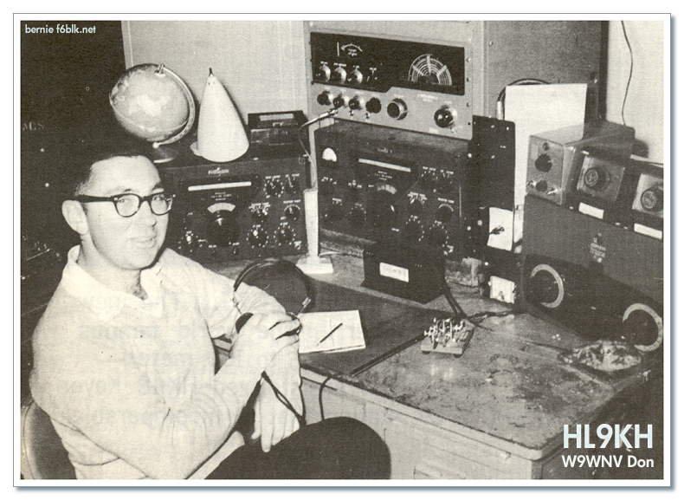
Miller’s activity whilst in the US Army

Slide 6
Miller’s activity whilst in the US Army
Date | Location | Call | Notes
1962 | Osan, South Korea | HL9KQ | Military Auxiliary Radio Service (MARS) station
1962 | South Korea | HL9KH | 1962 CQ WW CW Contest All Band Single Operator: Winner Scored 1,142,748 points 2nd Place: 4X4KK: 1,002,042 points
16 - 25 Feb.1963 | Rota Island, Mariana Islands | KG6R/W9WNV
1963 | South Korea | HL9KH | 1963 CQ WW Phone Contest Single Band (14Mhz) Single Operator: Winner Scored 318,060 points 2nd Place: VP7NS: 308,175 points
31 May – 2 June 1963 | Parece Vela (Okinotorishima) | KG61D | 2,379 QSOs
30 Aug. – 6 Oct. 1963 | Cambodia | W9WNV/XU | 7,000 QSOs
19-28 Oct. 1963 | Vietnam | W9WNV/3W8 | War zone
Nov,1963 | Laos | XW8BF | War zone

Slide 7
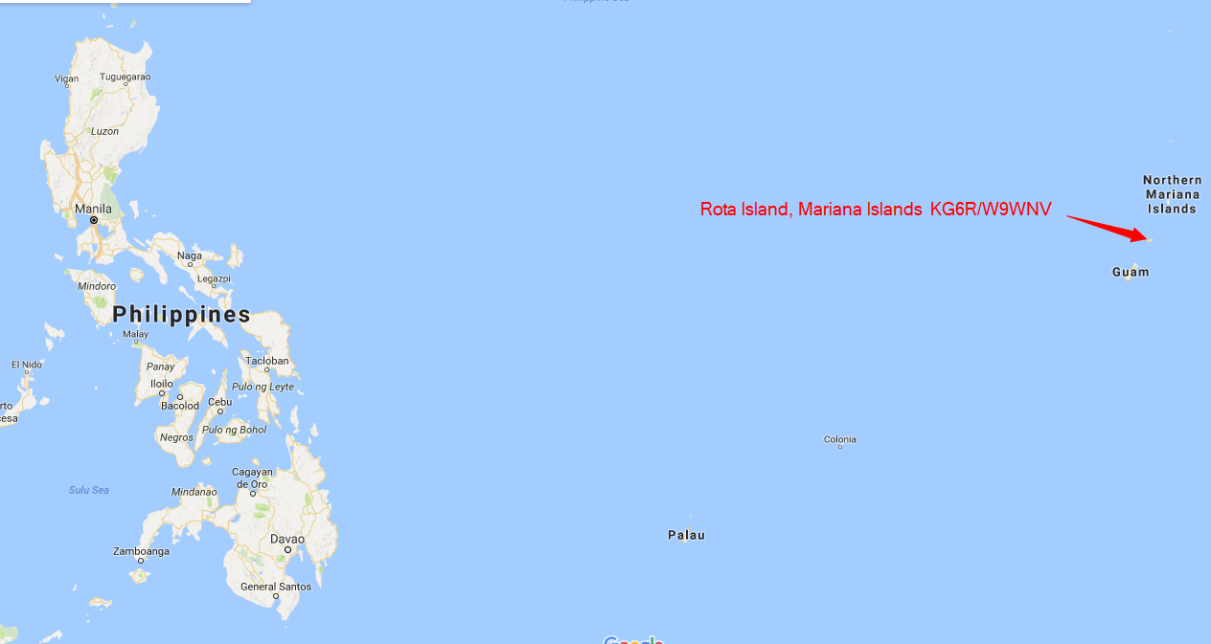
Rota Island, Mariana Islands (KG6R/W9WNV)
16 – 25 February 1963

Slide 8
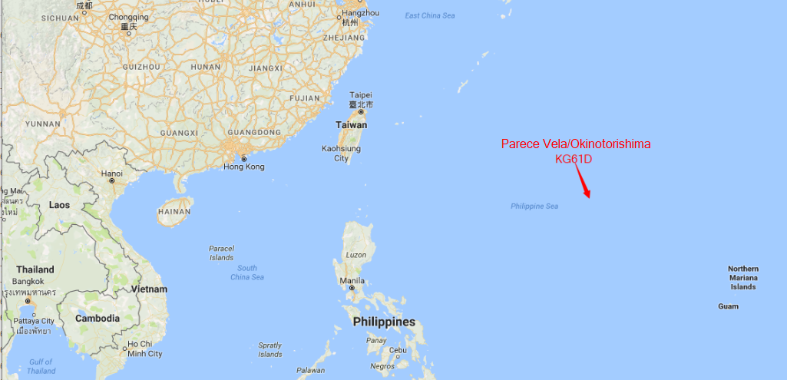
Parece Vela/Okinotorishima (KG61D)
31 May – 2 June 1963

Slide 9
Late 1963 – Mid 1965
Left the military.
Linked with World Radio Propogation Study Association (Facilitator: “Ack” Ackerson (W4ECJ), Birmingham, Alabama).
Planning for future DXpeditions.
Equipment to be used: Collins S Line (32S-3, 75S-3B, 203BA, 14AVQ, DP.
21 July 1965: Departed from New York with Chuck Swain (K7LMU).

Slide 10
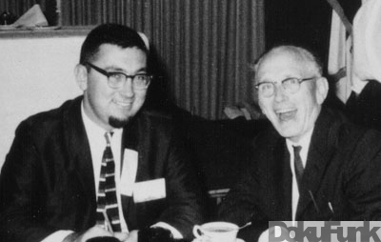
Don Miller with Gus Browning (W4BPD)

Slide 11
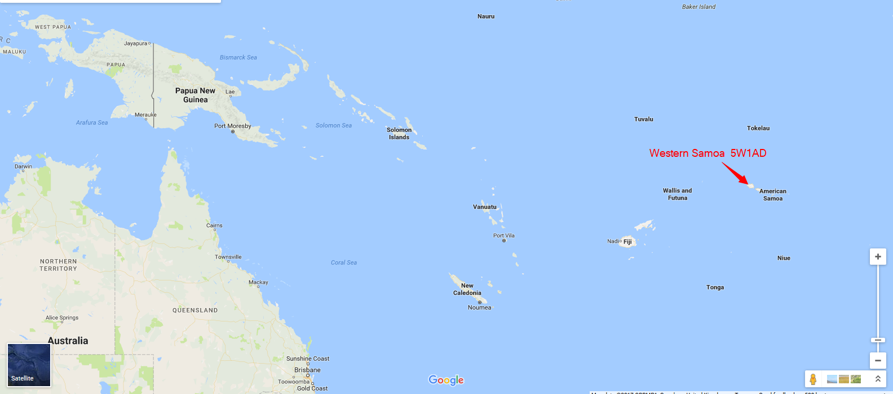
Western Samoa (5W1AD)
2 – 8 August 1965

Slide 12
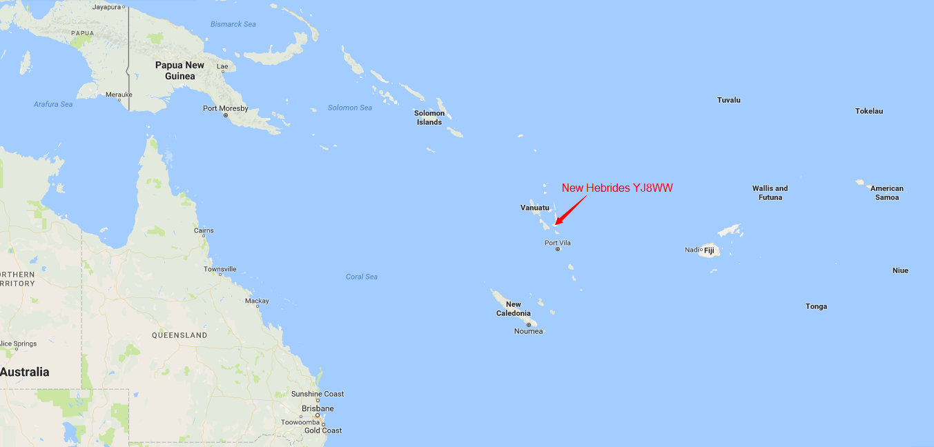
New Hebrides (YJ8WW)
14 August 1965

Slide 13
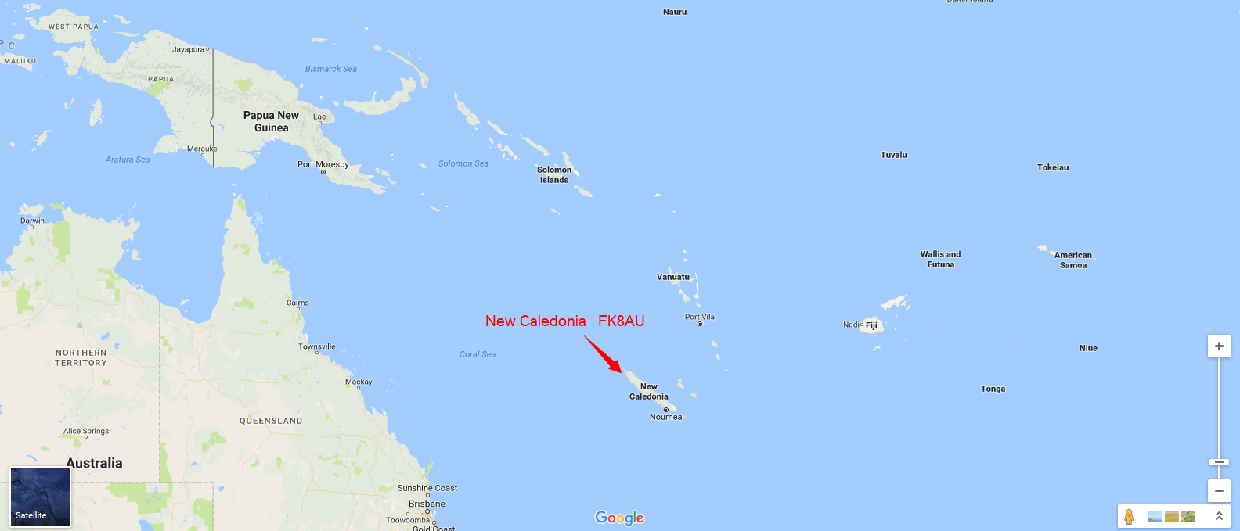
New Caledonia (FK8AU)
21 August 1965

Slide 14
August – 10 October 1965
Date | Location | Call | Notes
August 1965 | Australia | VK2ADY
5 - 9 September 1965 | China | BY4SK | CW only
10 September 1965 | Laos | XW8AW
11 – 15 September 1965 | Indonesia | W9WNV/8F3
22 – 27 September 1965 | Burma | XZ2TZ
3 – 10 October 1965 | Thailand | K7LMU/HS

Slide 15
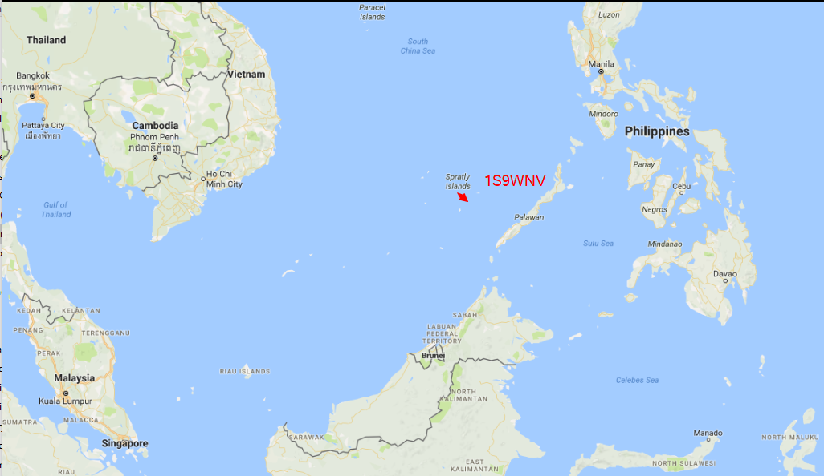
Spratly Islands (1S9WNV)
16 – 19 October 1965

Slide 16
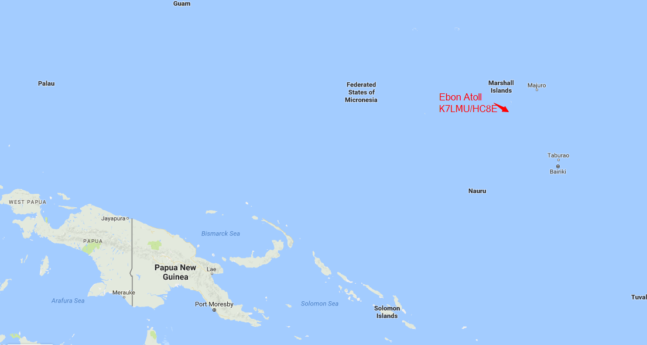
Ebon Atoll (K7LMU/HC8E)
27 – 30 October 1965

Slide 17
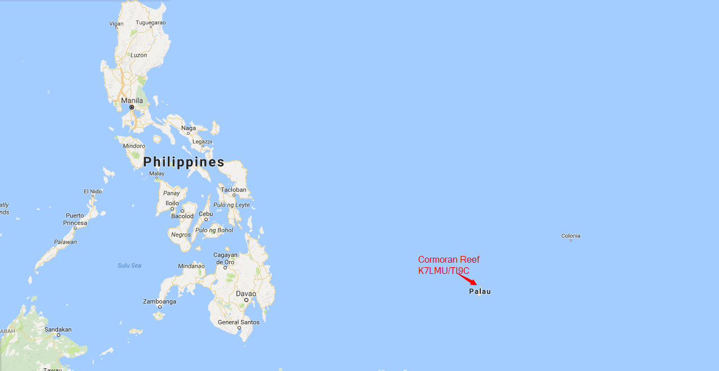
Cormoran Reef (K7LMU/TI9C)
2 – 16 November 1965

Slide 18
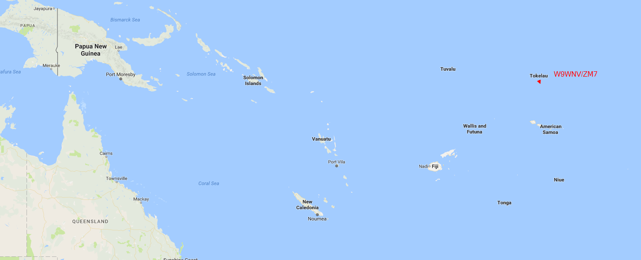
Tokelaus (W9WNV/ZM7)
15 – 16 November 1965

Slide 19
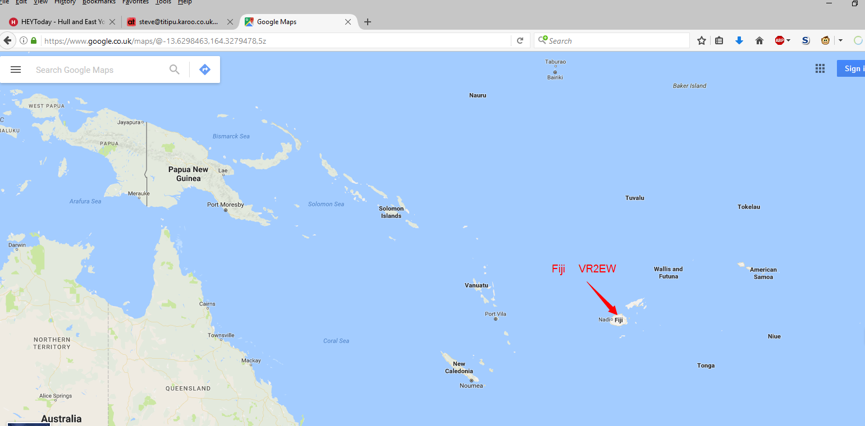
Fiji (VR2EW)
27 – 28 November 1965

Slide 20
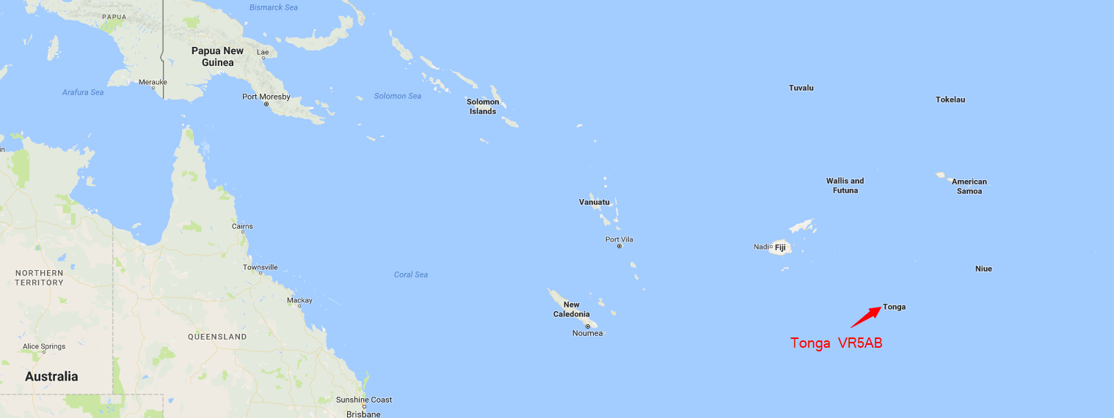
Tonga (VR5AB)
15 – 21 December 1965

Slide 21
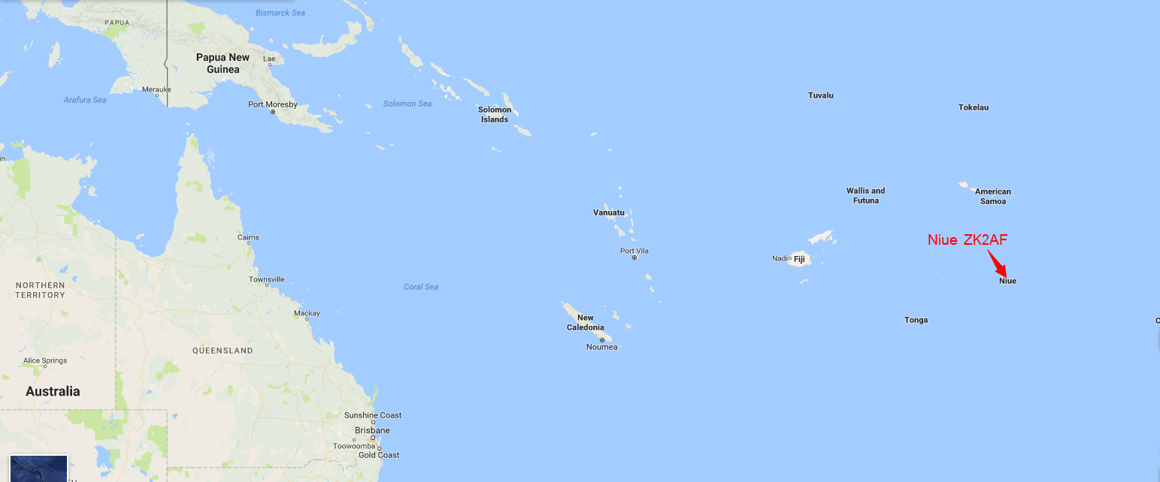
Niue (ZK2AF)
1 – 5 January 1966

Slide 22
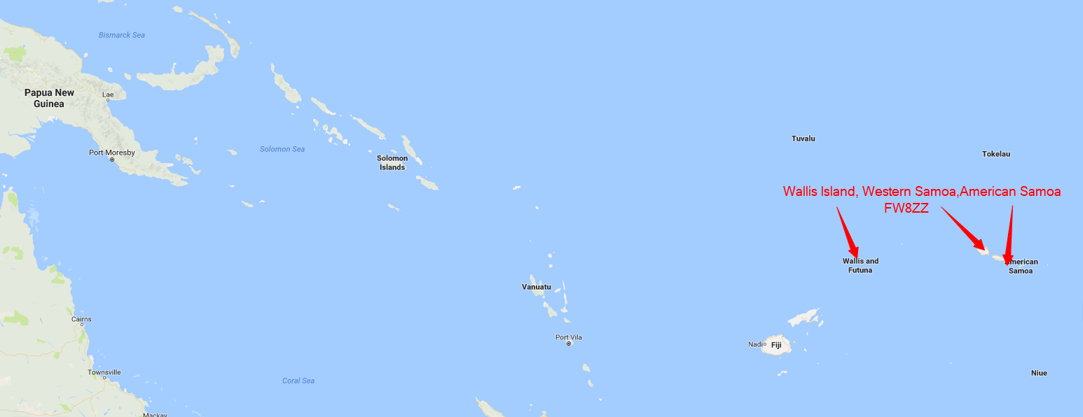
Wallis Island (FW8ZZ)
10 – 26 January 1966

Slide 23
12 February – 30 March 1966
Date | Location | Call | Notes
12 – 13 February 1966 | Australia | VK2ADY
 | New Caledonia | FK8AU
 | Fiji | VR2EW
30 March 1966 | American Samoa | KS6BO

Slide 24
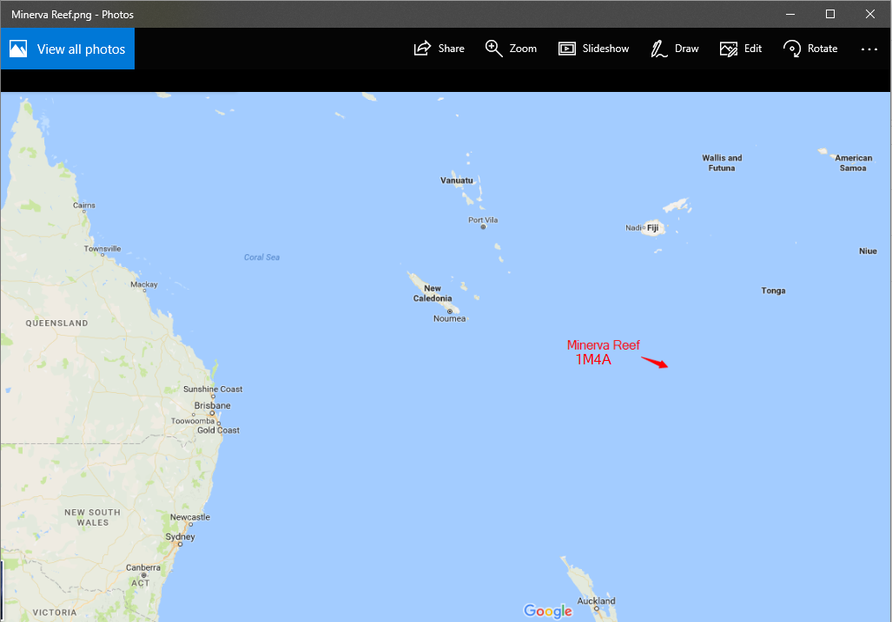
Minerva Reef (1M4A)
16 – 18 April 1966

Slide 25
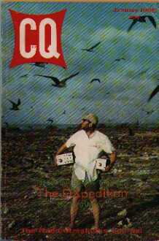
Maria Theresa Reef (W9WNV/FO8M)
26 April 1966

Slide 26
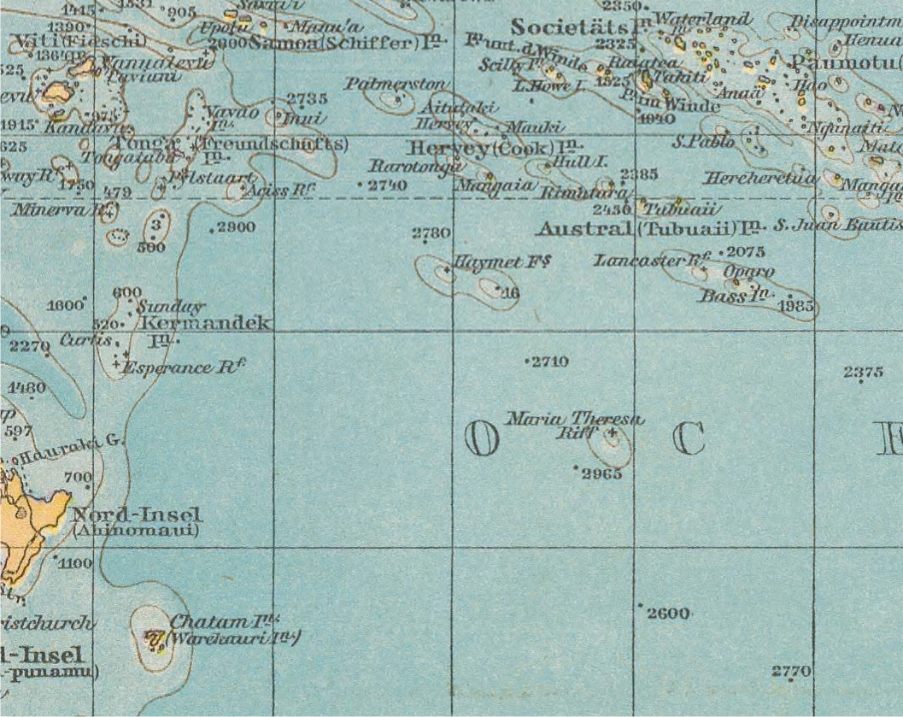
Maria Theresa Reef (W9WNV/FO8M)
26 April 1966 1881 Map

Slide 27
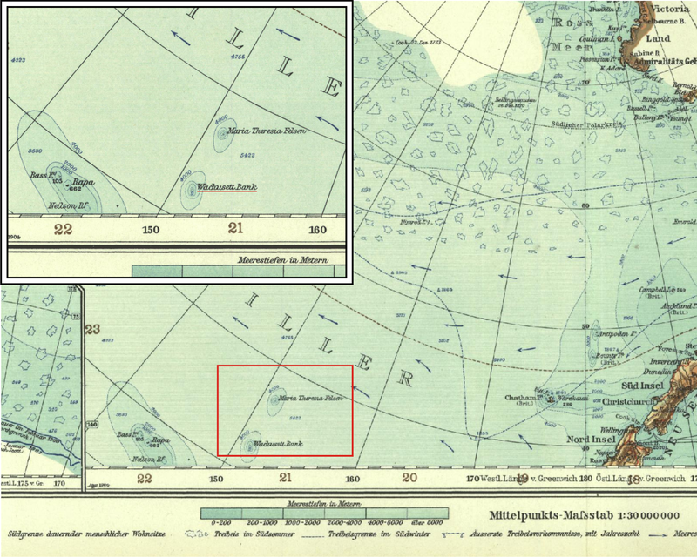
Maria Theresa Reef (W9WNV/FO8M)
26 April 1966 1904 German Map

Slide 28
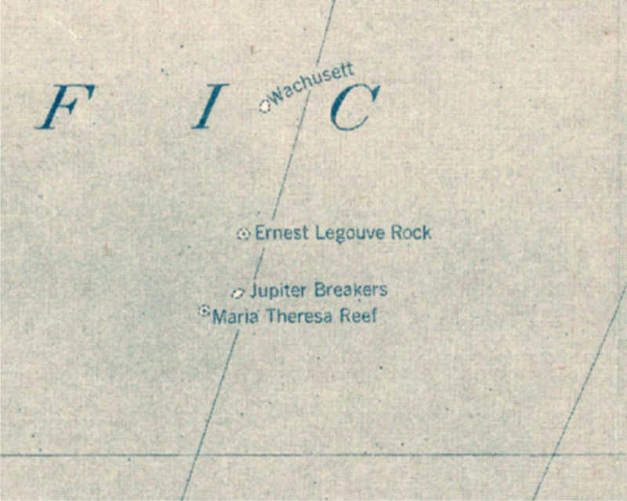
Maria Theresa Reef (W9WNV/FO8M)
26 April 1966 1921 Map

Slide 29

Maria Theresa Reef (W9WNV/FO8M)
QSL Card

Slide 30
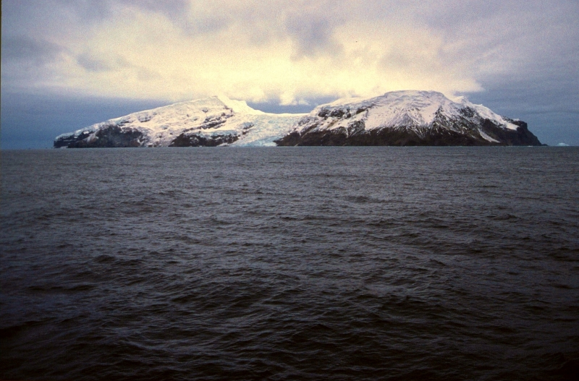
How to find an island, lose it & find it again!
In this case Bouvet Island

Slide 31
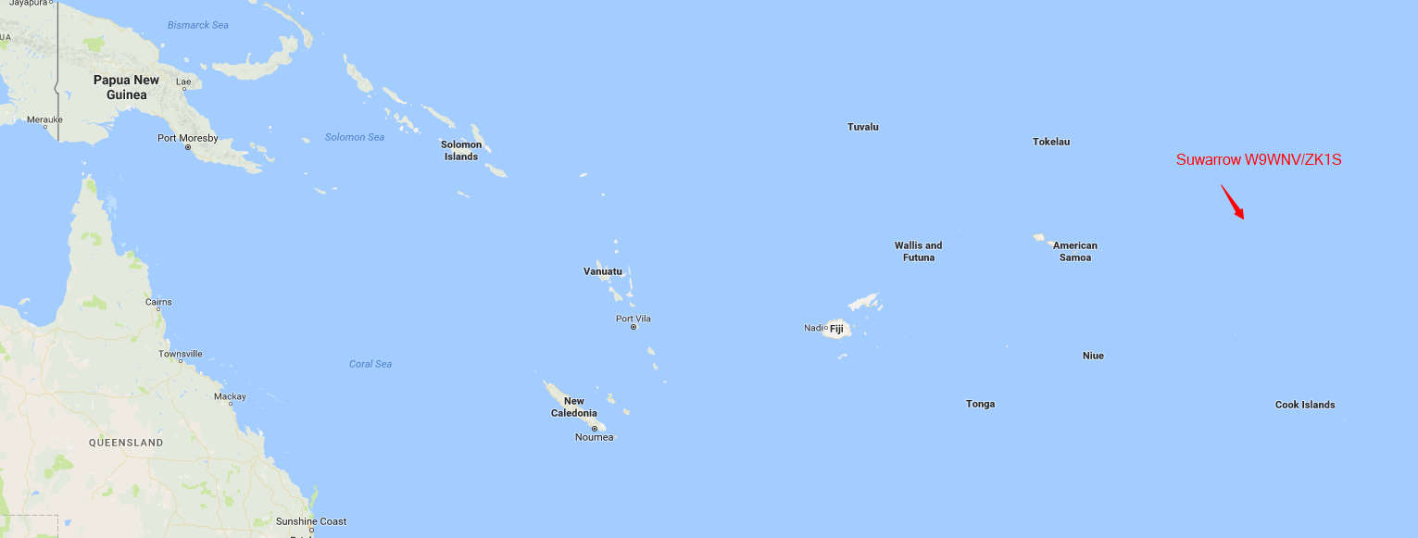
Suwarrow Atoll (W9WNV/ZK1S)
7 – 9 May 1966

Slide 32

Suwarrow Atoll (W9WNV/ZK1S)
7 – 9 May 1966

Slide 33
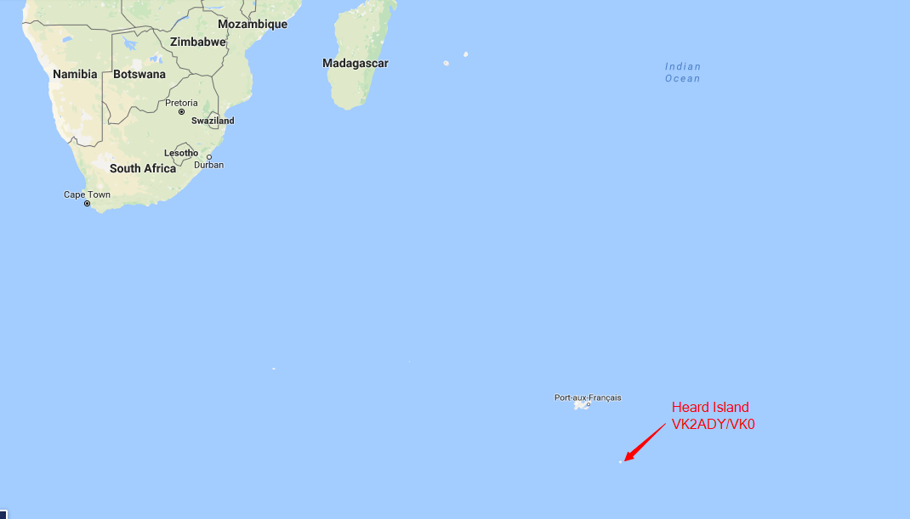
Heard Island (VK2ADY/VK0)
9 – 12 July 1966

Slide 34
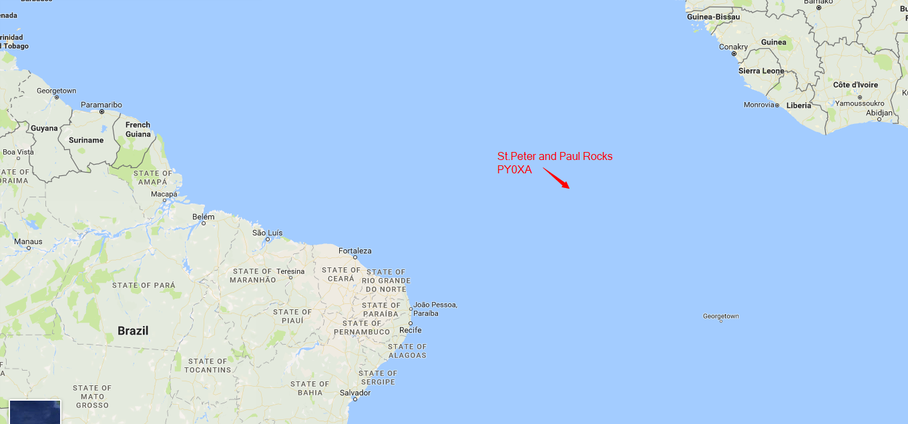
St. Peter & St. Paul Rocks (PY0XA)
21 – 22 August 1966

Slide 35
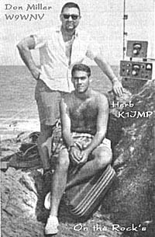
St. Peter & St. Paul Rocks (PY0XA)
21 – 22 August 1966

Slide 36
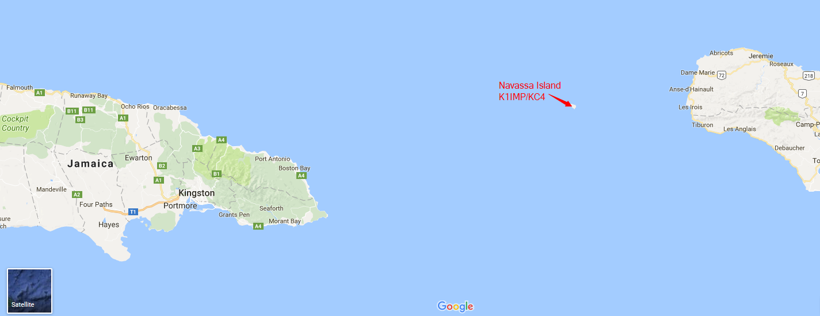
Navassa Island (K1IMP/KC4)
31 August – 2 September 1966

Slide 37
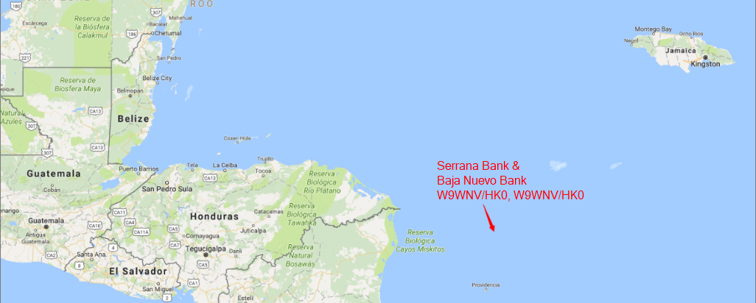
Serrana Bank (W9WNV/HK0), 5 – 6 September 1966
Bajo Nuevo Bank (W9WNV/HK0), 8 – 9 September 1966

Slide 38
Bajo Nuevo Bank (W9WNV/HK0)
8 – 9 September 1966

Slide 39
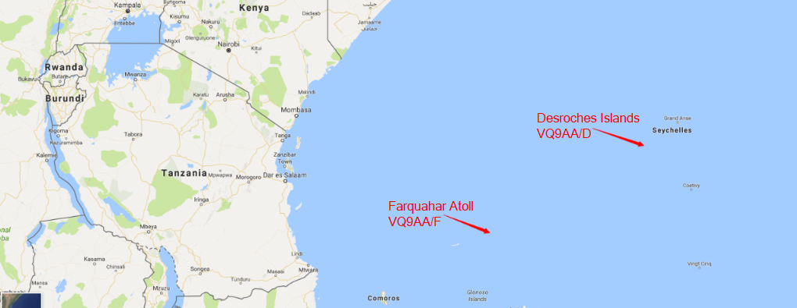
Desroches Island (VQ9AA/D), 17 – 27 October 1966
Farquahar (VQ9AA/F), 4 November 1966

Slide 40
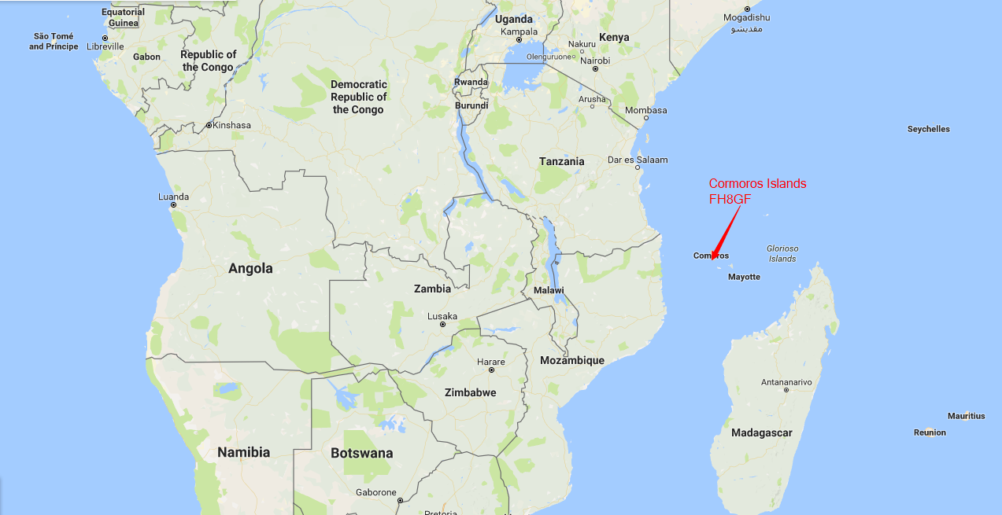
Comoros Island (FH8GF)
8 – 10 November 1966

Slide 41
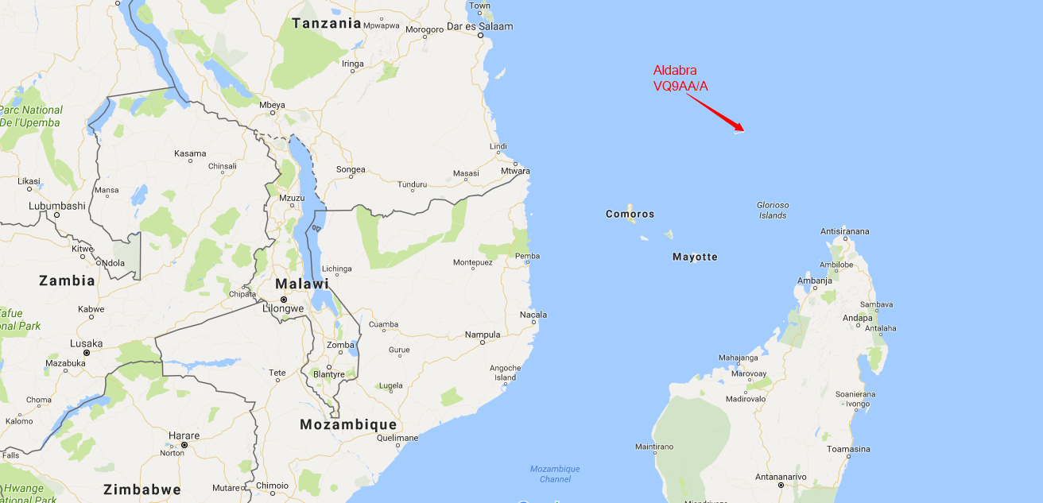
Aldabra (VQ9AA/A)
14 – 17 November 1966

Slide 42
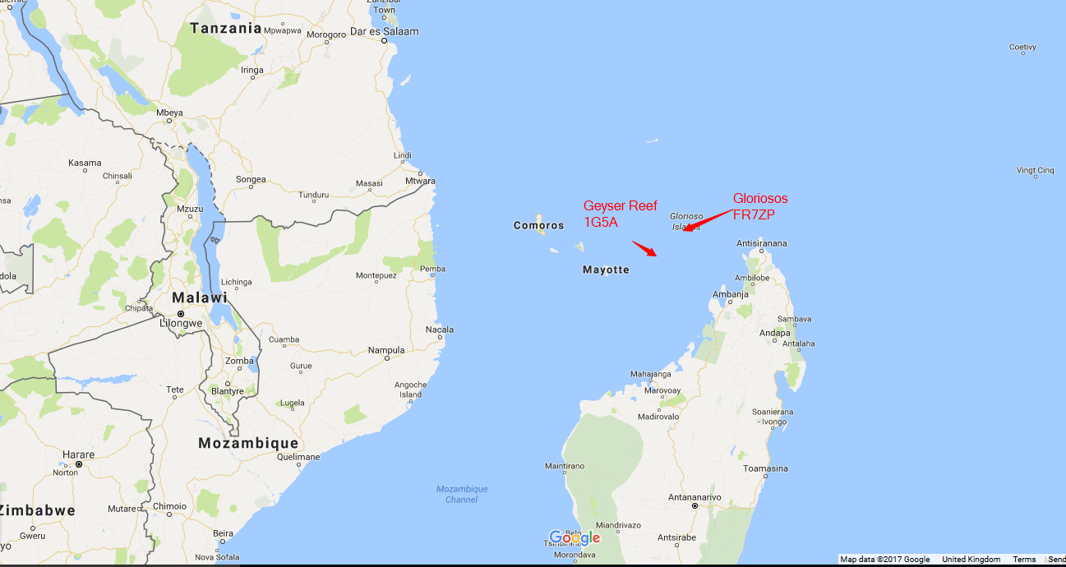
Glorieuses (FR7ZP), 20 November 1966
Geyser Reef (1G5A), 23 – 25 November 1966

Slide 43
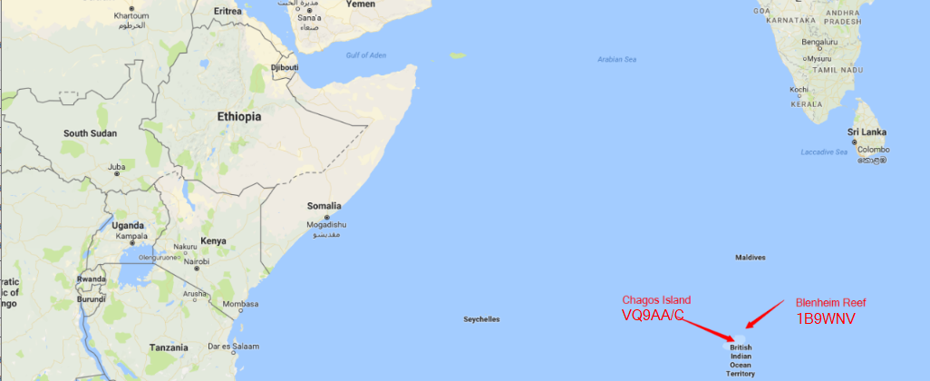
Chagos Island (VQ9AA/C), 19 – 22 January 1967
Blenheim Reef (1B9WNV), 23 January 1967

Slide 44
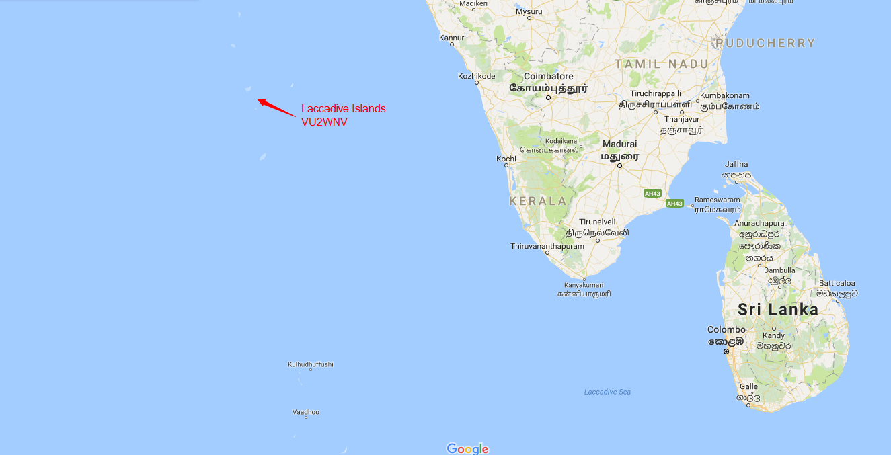
Laccadive Islands (VU2WNV)
27 – 28 January 1967

Slide 45
Miller v ARRL: Part 1
20 February 1967: ARRL publishes 10 page document relating to Miller’s DXpeditions – bottom line being that the ARRL would not accept any QSLs for his DXpeditions for DXCC.
26 February 1967: Miller travelling to Geyser Reef when he got news about the document.
Miller returned to the USA for meeting with ARRL.
Meeting between Miller & ARRL Awards Committee at ARRL HQ in Newington

Slide 46
Miller v ARRL: Part 1
The ARRL’s Accusations:
  Poor sportsmanship
  Issuing QSLs for QSOs that never took place
  Avoiding QSOs with leading Dxers
  Misrepresenting certain foreign consulate activities to the Awards Committee
  Navassa Island DXpedition damaged the prestige of amateur radio in government circles
  Cheeting in 2 contests
Result: Credit for 6 countries suspended for these visits & any future visits

Slide 47
Miller v ARRL: Part 1
Meeting with Awards Committee was inconclusive after 5 hours
Miller documented his defence in an 85 page response to the ARRL’s claims. The document was sent to his supporters both at home & abroad
Miller requested meeting with ARRL Board of Directors
John Huntoon (W1LVQ, ARRL General Manager) was opposed to this meeting but the meeting went ahead on 5 May 1967 at Hartford, Connecticut lasting 4 hours & discussing 10 of Miller’s DXpeditions

Slide 48
Miller v ARRL: Part 1
Outcome of the meeting:
Credits were granted for QSOs with:
1M4A (Minerva Reef)
FR7ZP (Glorieuses)
VQ9AA/A (Aldabra)
VQ9AA/D (Des Roches Island)
Credits not granted for QSOs with:
K1IMP/KC4 (Navassa Island)
VU2WNV (Laccadive Islands)

Slide 49
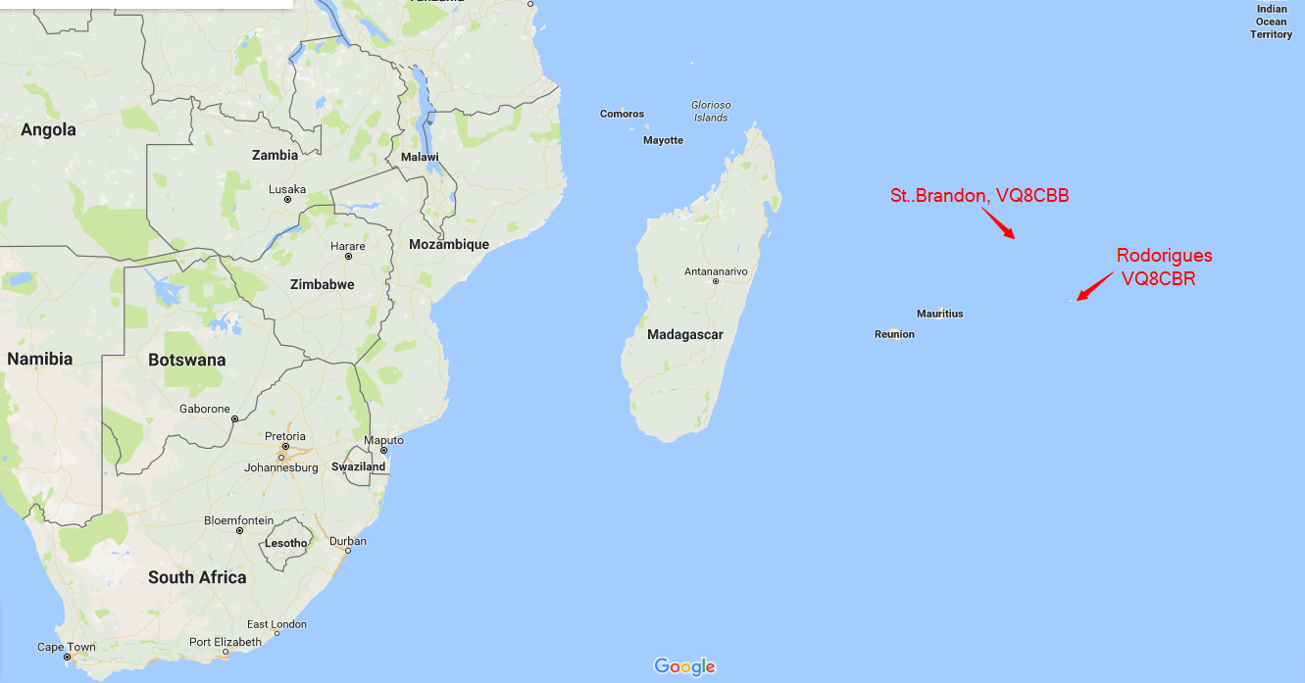
St. Brandon (VQ8CBB), 22 – 30 Aug. 1967
Rodoriguez (VQ8CBR), 9 – 14 September 1967

Slide 50
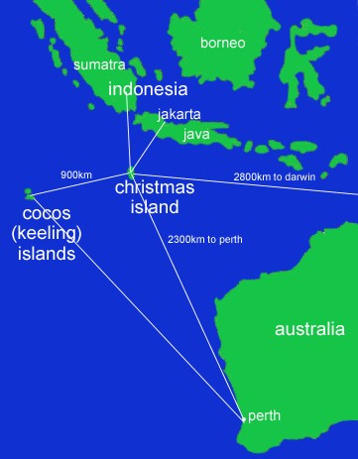
Cocos Islands (VK2ADY/9)
14 – 31 Oct. 1967

Slide 51
Malagasy Republic (5R8BA)
25 – 26 November 1967
Now Madagascar
Area 226,660 square miles
Population – estimated 5,590,000 in 1961
1967 CQ WW CW Contest
All Band Single Operator: Not Placed
“Scored” 2,614,877 points – would have won!
Log submitted too late

Slide 52
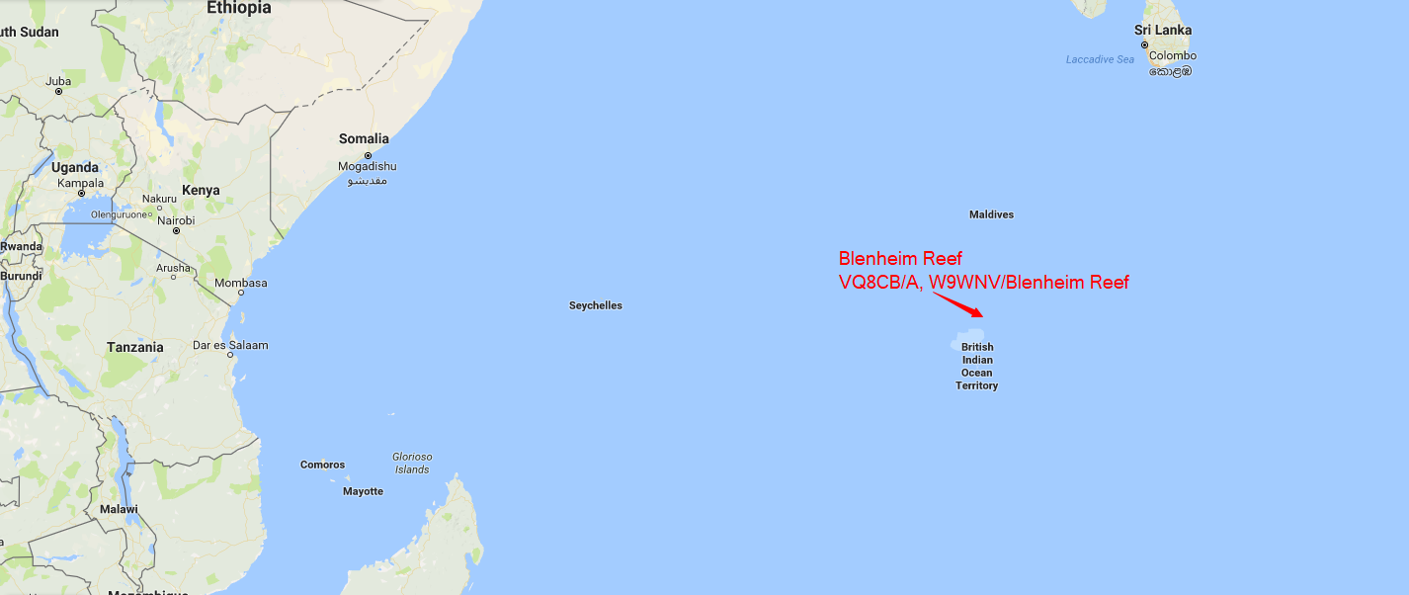
Blenheim Reef (VQ8CB/A, W9WNV/Blenheim)
8 – 10 December 1967

Slide 53
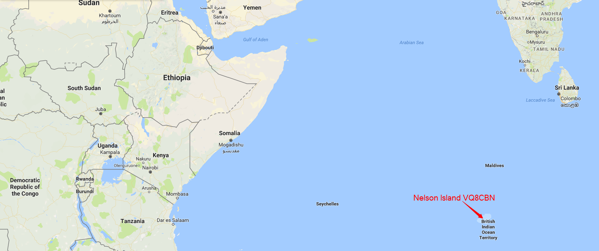
Nelson Island (VQ8CB/N)
16 – 17 December 1967

Slide 54
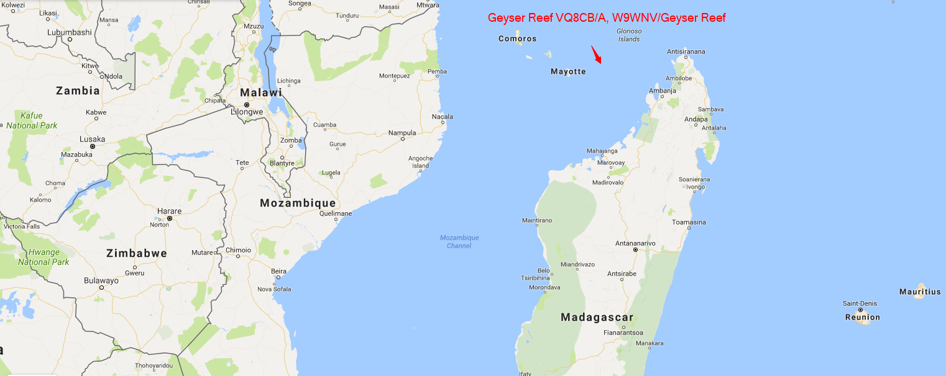
Geyser Reef (VQ8CB/G, W9WNV/Geyser Reef)
30 – 31 December 1967

Slide 55
Miller v ARRL: Part 2
19 February 1968: Miller sues John Huntoon & the ARRL for over $550,000 for defamation (libel with malice) relating to the document the ARRL published on 20 February 1967.
11 June 1968: Miller started his deposition. It took 3 days.
  He admitted to not visiting the St. Peter & St. Paul Rocks.
  Miller couldn’t remember details of his visits to Chagos, Laccadive Islands, Blenheim Reef & Heard Island.
14 June 1968: Huntoon made his deposition.
15 June 1968:Miller signed an agreement to withdraw his lawsuit. No money changed hands between Miller, Huntoon & the ARRL.

Slide 56
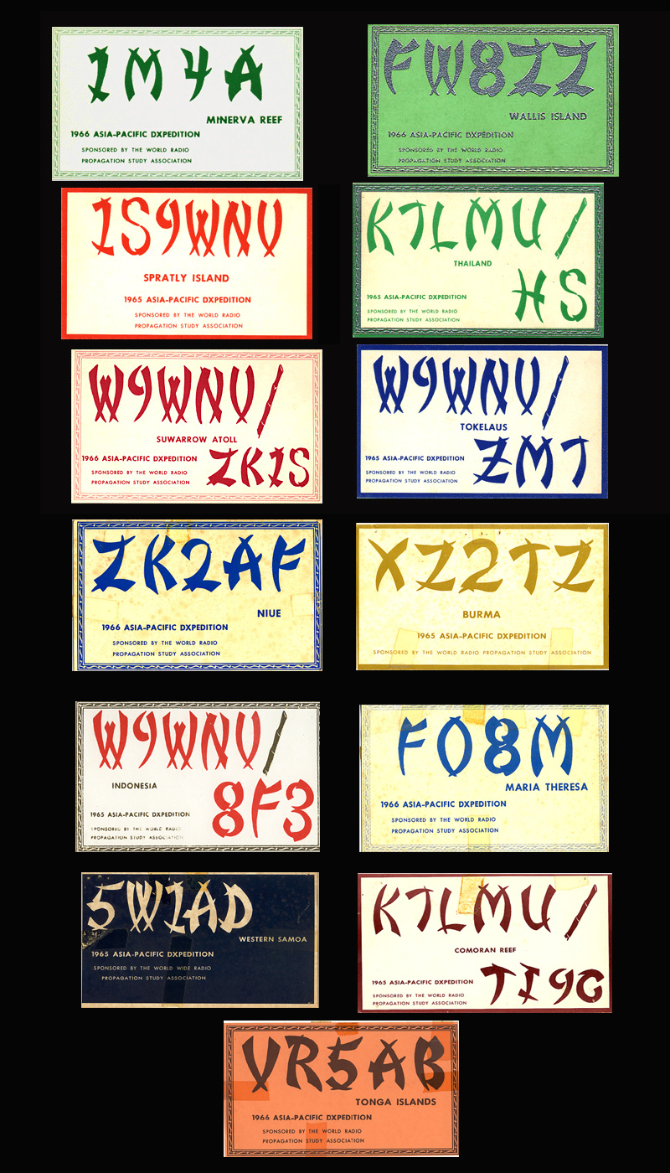
Don Miller QLS Cards

Slide 57
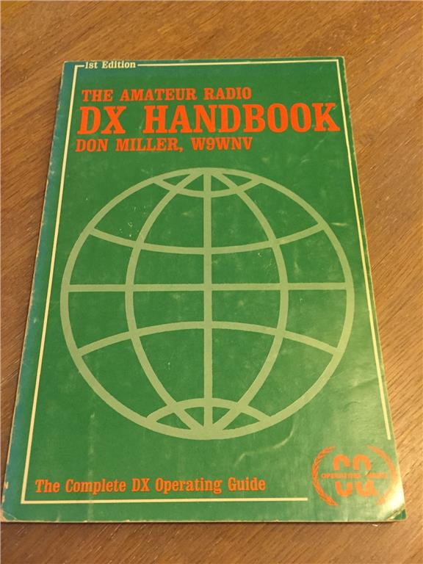
Don Miller: Author!

Slide 58
Miller’s Later Life
Date | Location | Callsign | Notes
28 Sep. 1974 | Holiday Inn, Seattle |  | Application for life membership of the ARRL rejected although all other 236 applications were accepted. Allowed to keep his rights & privileges as a member.
1980 | Indio, California |  | Miller convicted of conspiracy to kill his estranged wife Susan Claire Miller. Sentenced to 25 years imprisonment.
2002 |  |  | Miller granted parole.
2002 |  | AE6IY | Miller relicensed.
2002 | Hamvention, Dayton, Ohio |  | Miller appeared at one of the DX forums & made an apology for what had happened in the 1960s.

Slide 59
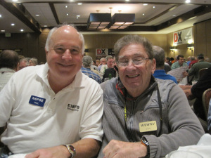
Hamvention, Dayton Ohio 2015

Slide 60
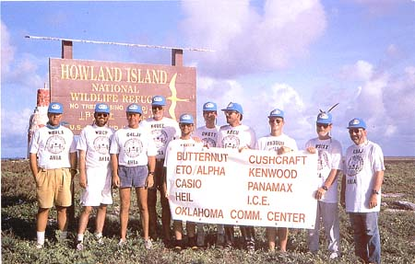
How to prove you really are where you say you are

Slide 61
And the supporting documentation!
Passports & visas with entry & exit stamps
Documentation approving visits to some locations
Documentation relating to callsigns to be used
Airline &/or boat tickets
Ship’s log

Slide 62
So what where Don Miller’s Dxpedition “crimes”
Not being where he said he was
Ignoring people who were at the top of the DXCC Honour Rolls but working people who had made contributions to the WRPSA of $25 or more
Cutting corners
Lack of documentation
Lack of proof that he was where he said

Slide 63

Is Don Miller a DXpedition
Hero or Villain?

