Slide 1
History of Amateur Radio in
East Yorkshire
Hull & District Amateur Radio Society
Tony Cobb 27 April 2017
G0WJK

Slide 2
Presentation Overview
How the information has been collected
Clubs & societies in East Yorkshire
History of HADARS
  Earliest evidence of a club in Hull
  1931 – 1939
  1939 – 1945
  1945 – 1986
  1987 – Present
Future research
Questions

Slide 3
How the information was collected
Tony
  600 Bulletins/RadComs
  150 Short Wave Magazines
  Books
  RSGB CDs of Bulletins/RadComs
National Radio Centre/RSGB
  2 visits made
  Every Bulletin/RadCom back to 1925 checked
  Short Wave Magazines not catalogued but being scanned
  Large number of books donated
Other publications
Websites

Slide 4
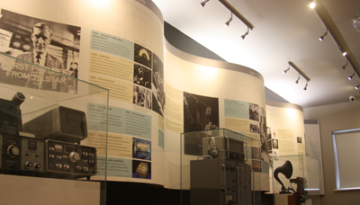
National Radio Centre: History of Radio

Slide 5
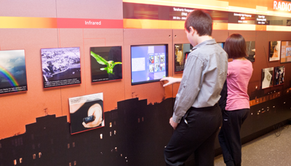
National Radio Centre: Interactive Zone

Slide 6
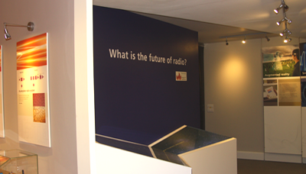
National Radio Centre: Radio’s Future

Slide 7
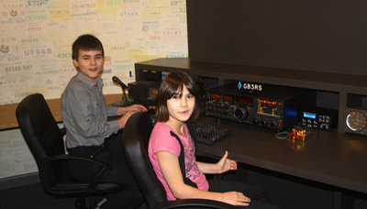
National Radio Centre: GB3RS

Slide 8
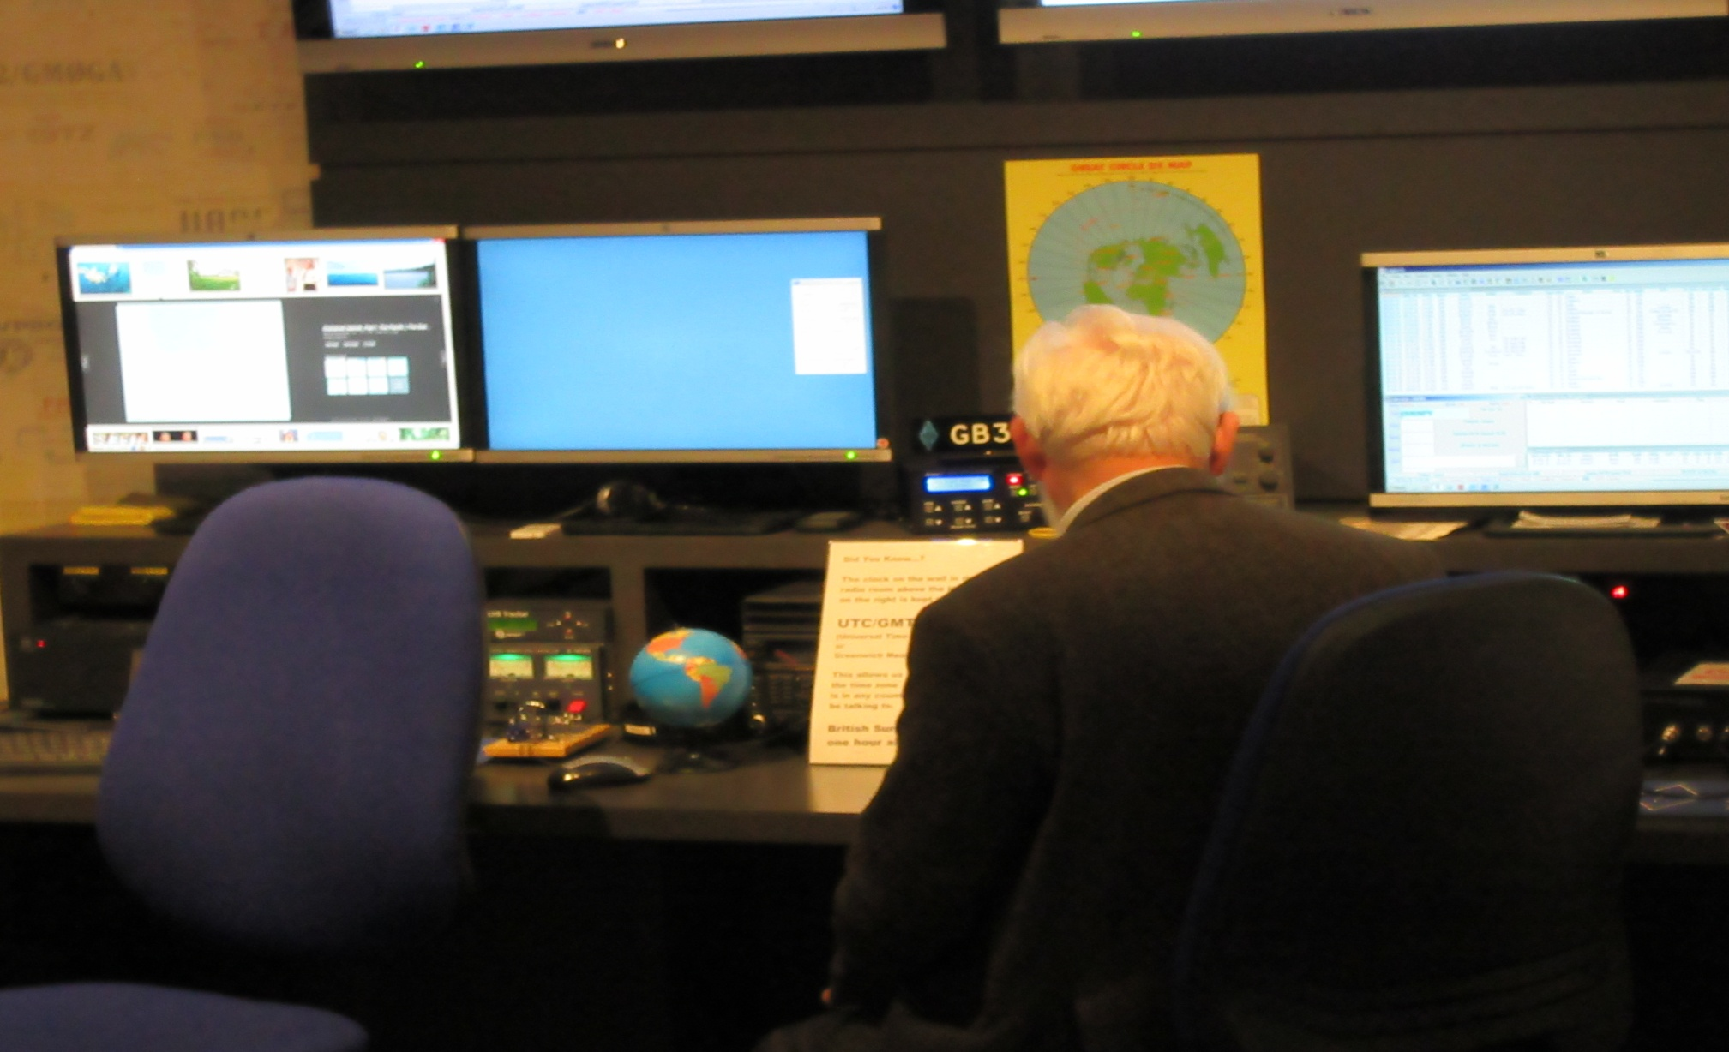
National Radio Centre: GB3RS

Slide 9
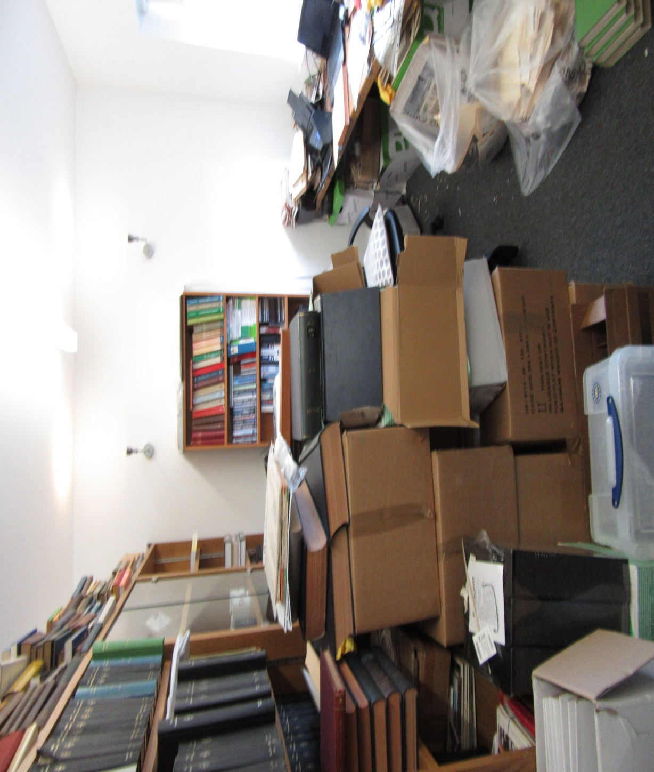
National Radio Centre: Office

Slide 10
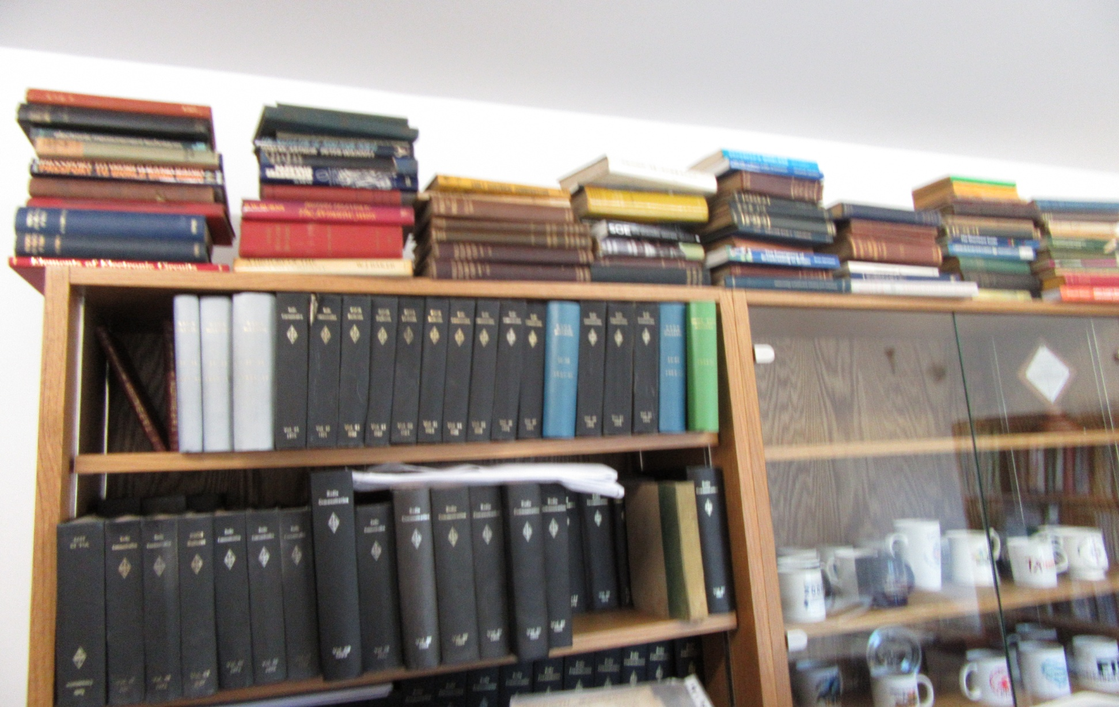
National Radio Centre: Office

Slide 11
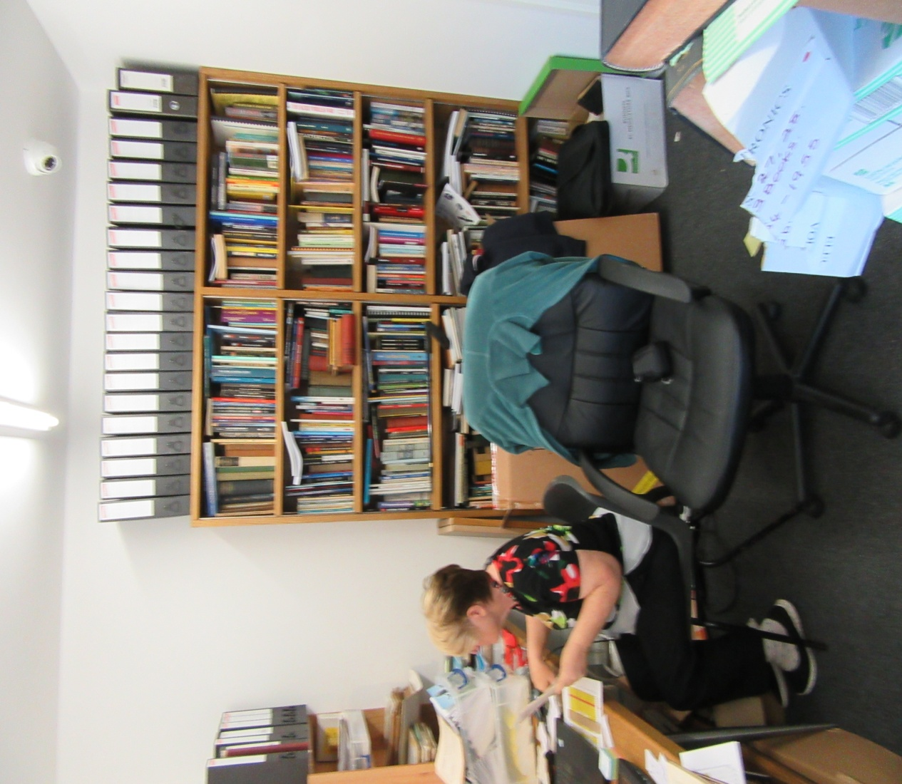
National Radio Centre: Office

Slide 12
Issues With Collecting Information
Historical RSGB admin. documents not available
Historical HADARS admin. documents not available

Slide 13
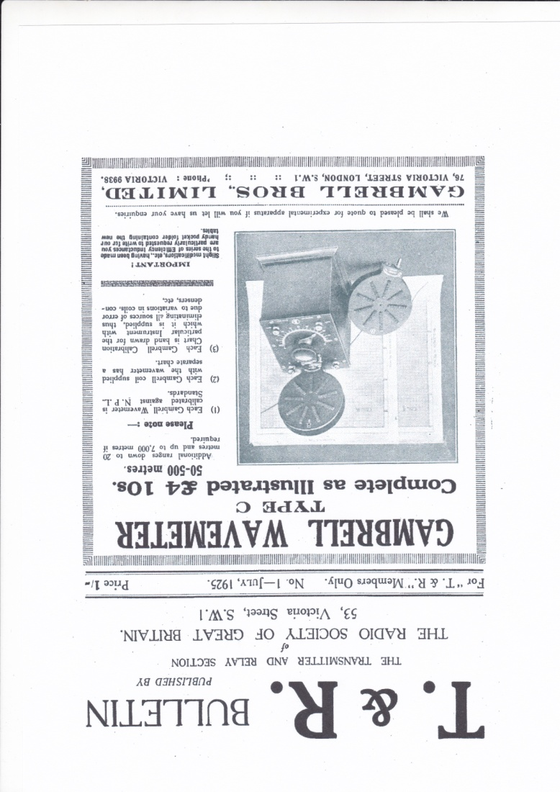
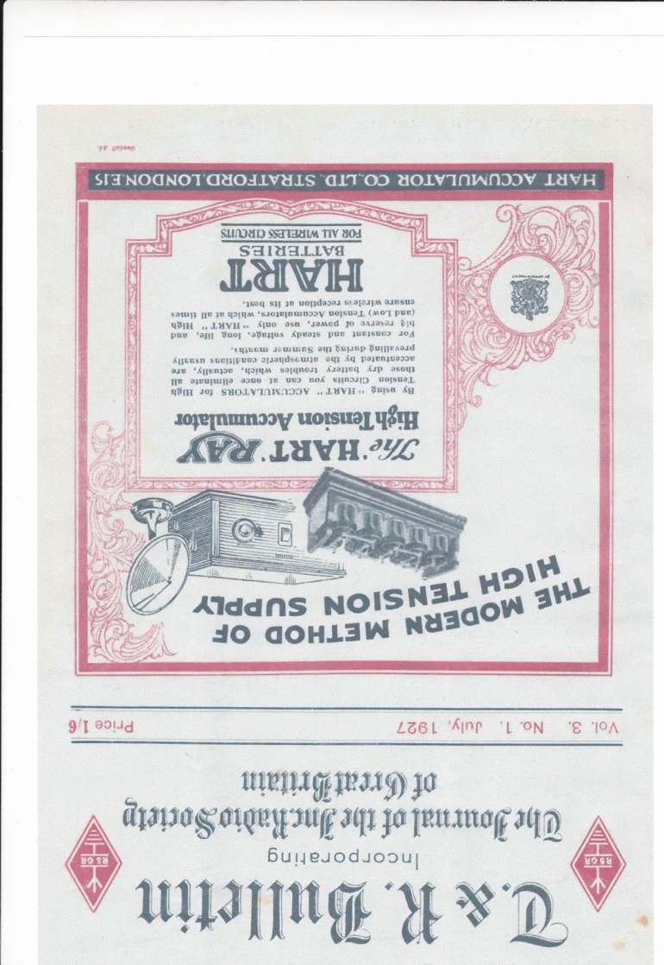
Early T&R Bulletins

Slide 14
Clubs & Societies in East Yorkshire
Bridlington: 1934 - ????, 1960 - 1963, 1992 - 1994
Goole: 1976 – Present
Hornsea: 1977 – Present
Hull & District: 1921, 1932, 1934, 1939, 1952 – Present
Hull University: 1977 – 1984
Humber Fortress DX Club: 2010 – Present
Leconfield ASMT RCT: 1982 – 1989
North Ferriby United/East Yorkshire: 1987 – 2010
Raywell Park Scouts : 1998 – 2003
East of Greenwich/Withernsea: ???? – Present

Slide 15
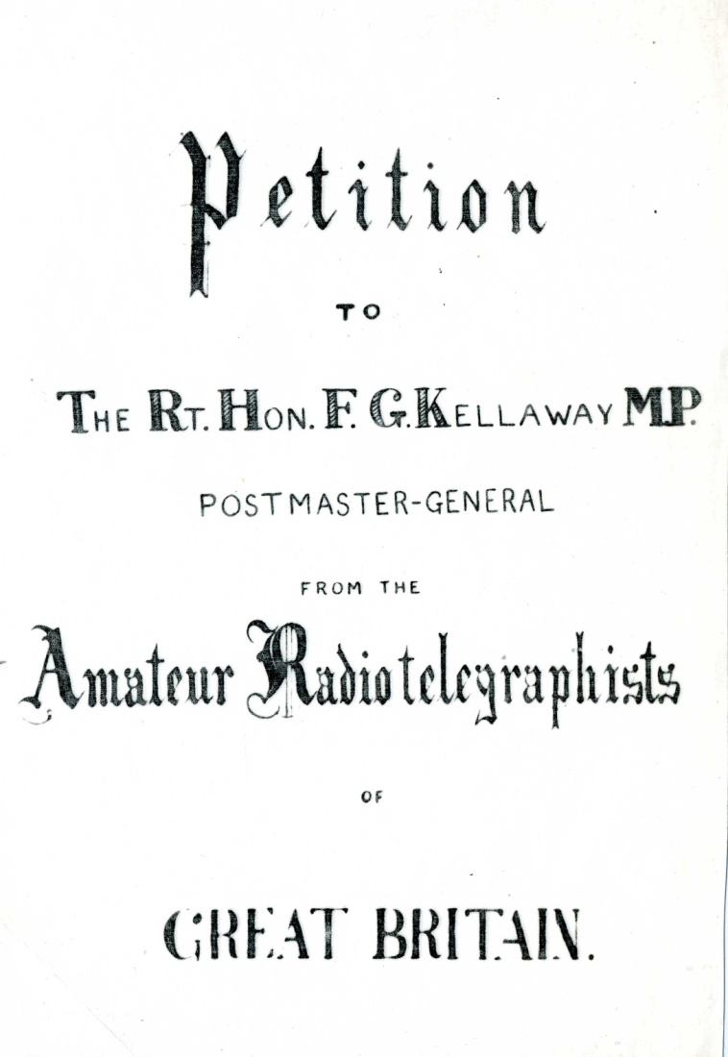
History of HADARS: Earliest Evidence

Slide 16
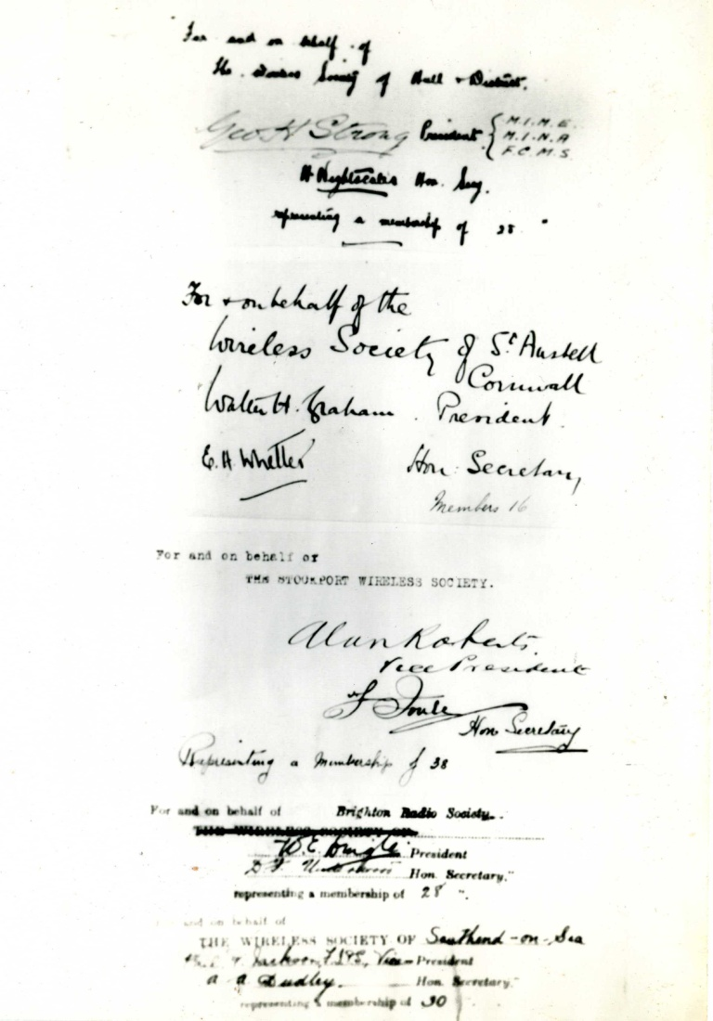
History of HADARS: Earliest Evidence

Slide 17
History of HADARS: 1931 - 1939
Month/Year | Event
January 1931 | Meetings of RSGB members at members’ homes Hull was in District 2 (Yorkshire, Northumberland, Durham)
August 1932 | New group in Hull Hull moved to District 17: (East Yorkshire, Lincolnshire & Rutland)
April 1933 | District 17 Conventionette held at the Grosvenor Hotel, Carr Lane, Hull. John Clarricoats, G6CL & RSGB Secretary, travelled from London to attend
June 1933 | NFD Results: District 17 finished 4th
January 1934 | District 18 (East Yorkshire, Part of North Yorkshire) boundaries agreed
February 1934 | First meeting of Hull Short Wave Society - 15 attendees
June 1934 | NFD: District 18 finished 2nd

Slide 18
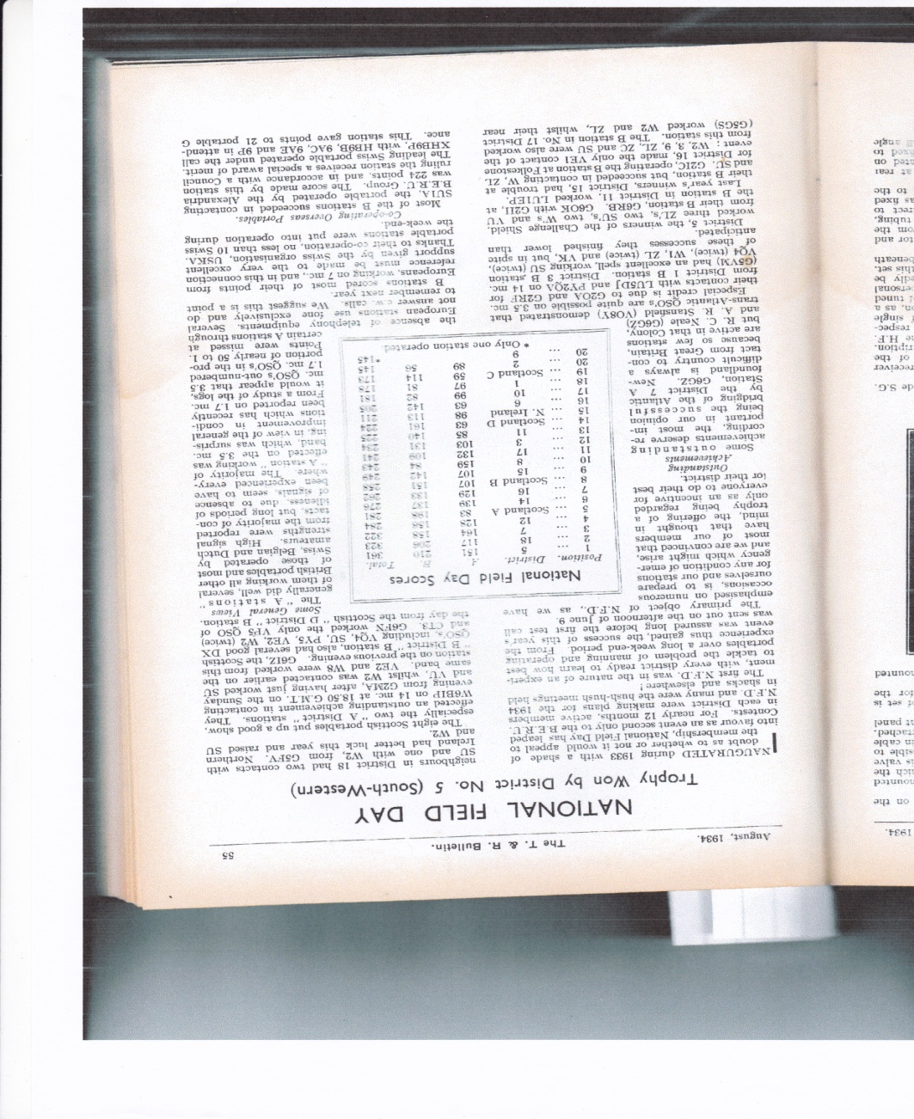
History of HADARS: 1931 - 1939

Slide 19
History of HADARS: 1931 - 1939
Month/Year | Event
August 1934 | Hull Short Wave Club flourishing
October 1934 | Hull Short Wave Club having fortnightly meetings
June 1935 | NFD: District 18 (G6OO, G5FV) finished 7th
November 1935 | Hull & District meetings moved to YPI, George St., Hull
June 1936 | NFD: District 18 finished 15th
October 1936 | Meetings taking place fortnightly at the YPI
January 1937 | Meetings at YPI stopped due to costs
April 1937 | Meetings held at 341 Beverley Road, Hull on fourth Wednesday of each month

Slide 20
History of HADARS: 1931 - 1939
Month/Year |  | Event
 | June 1937 | NFD: District 18 finished 8th G6OO: Garrowby Hill, G8KU: Oliver’s Mount, G2XA: Elloughton
 | June 1938 | NFD: District 18 finished 24th G6OO: Garrowby Hill, G8KU: Oliver’s Mount, G2XA: Elloughton
 | November 1938 | Meeting at Broadway Hotel, Ferensway, Hull
 | February 1939 | Short Wave Club for Hull & District: Committee formed to discuss details & report later
 | March 1939 | Agreed to allow non-RSGB members to attend meetings. Properly constituted club to be formed if more people attended meetings

Slide 21
History of HADARS: 1931 - 1939
Month/Year |  | Event
 | May 1939 | At a recent meeting Hull members decided not to use the Bulletin to record their activities!
 | June 1939 | NFD: District 18 finished 20th
 | September 1939 | Meeting to be held at Broadway Hotel, Ferensway, Hull

Slide 22
History of HADARS: 1939 - 1945
All transmitters had to be handed in but receivers could be kept.
Many radio amateurs recruited into the military.
No club meetings held in the Hull area until near the end of the war (2 September 1945) although people were regularly meeting in small groups at people’s houses.
Bulletin reduced in size due to shortage of paper but continued to be published. Advertisers continued to support the Bulletin throughout the war.

Slide 23
History of HADARS: 1945 - 1986
Month/Year |  | Event
 | January 1945 | Electronic Engineering Society formed in Hull catering for everyone interested in radio & allied subjects
 | March 1945 | Meeting of RSGB members held after a meeting of the Electronic Engineering Society
 | April 1945 | Meeting at the Imperial Hotel, Paragon Street, Hull

Slide 24
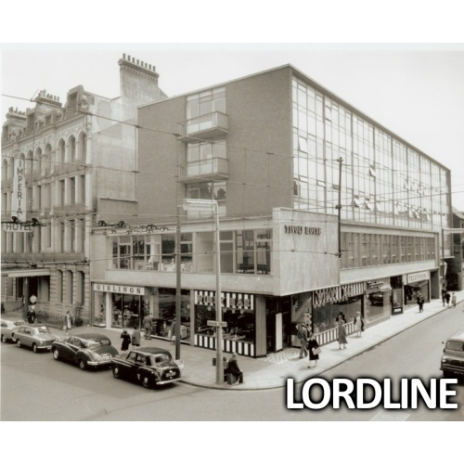
History of HADARS 1945 - 1986
Imperial Hotel, Paragon Street, Hull

Slide 25
History of HADARS 1945 - 1986
Month/Year |  | Event
 | June 1946 | Meeting at Short Wave (Hull) Radio, 30-32 Prince’s Avenue, Hull - owned by G5GX & G8IM
 | August 1946 | “First steps” taken towards obtaining club licence
 | October 1946 | G3AMW licence issued by GPO – full power & telephony
 | December 1946 | Club transmitter operational on 1.841MHz
 | June 1947 | NFD Results: Hull finished 6th A: G3CC/P, Keyingham, B: G6OS/P, Tranby Croft
 | September 1947 | Meeting at the Imperial Hotel, Paragon Street, Hull
 | November 1947 | Meeting at Short Wave (Hull) Radio, 30-32 Prince’s Avenue, Hull
 | December 1947 | Meeting at the Imperial Hotel, Paragon Street, Hull.

Slide 26
History of HADARS 1945 - 1986
Month/Year |  | Event
 | May 1948 | Region 2 Hull NFD stations: A: G2XA/P, Anlaby B: G2KO/P, Garton-on-the-Wolds
 | June 1948 | RSGB Affiliated Societies list: None in Hull
 | June 1948 | NFD results: Hull finished 61st A: G2XA/P, Anlaby B: G2KO/P, Garton-on-the-Wolds
 | March 1949 | Meeting at Ye Olde White Harte, Silver Street, Hull
 | May 1949 | RSGB Affiliated Societies list: None in Hull
 | December 1949 | Meeting at REME Barracks, Walton Street, Hull

Slide 27
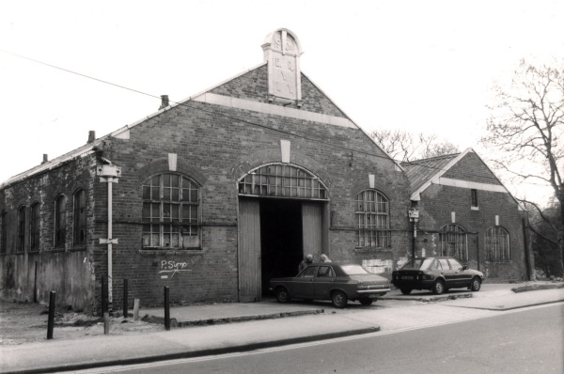
History of HADARS
REME Barracks, Walton Street, Hull

Slide 28
History of HADARS 1945 - 1986
Month/Year |  | Event
 | June 1951 | NFD results: Hull finished 73rd A: G2KO/P, B: G3PL/P,
 | July 1952 | Hull & District Radio Society formed
 | November 1952 | Hull & District Radio Society affiliated to RSGB
 | December 1952 | Meeting at Rampant Horse, Paisley Street, Hull

Slide 29
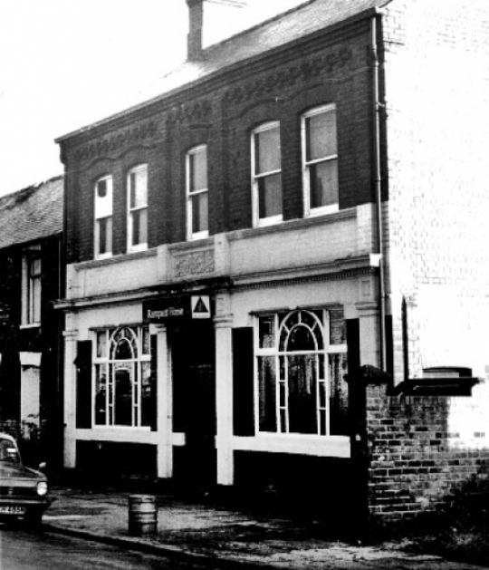
History of HADARS 1945 - 1986
Rampant Horse, Paisley Street, Hull

Slide 30
History of HADARS:1945 - 1986
Month/Year | Event
June 1954 | NFD Results: Finished joint 20th G2DPA/P, Beverley Westwood B: G2CNX/P, Welwick
June 1955 | NFD Results: Finished joint 21st
April 1956 | Meeting at Royal Oak (Tony’s), Spencer Street, Hull & Rampant Horse, Paisley Street, Hull
June 1956 | NFD Results: Finished joint 23rd (G3GWT/P & G2CPS/P)

Slide 31
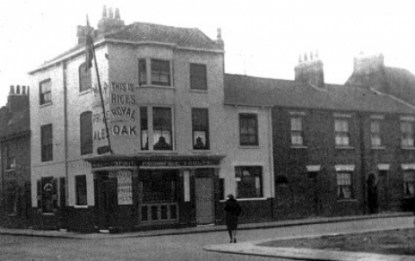
History of HADARS:
Royal Oak Hotel (Tony’s), Spencer Street, Hull

Slide 32
History of HADARS: 1945 - 1986
Month/Year | Event
June 1957 | NFD Results: Finished 29th (G2CPS, G2FS)
June 1958 | NFD Results: Hull Group finished 36th (G2CPS ,G3EFR)
June 1959 | NFD Results: Finished 78th (G3EFR)
June 1960 | NFD Results: Finished 38th (G2FS, G3CSE)
June 1961 | NFD Results: Finished 75th (G3EFR)
June 1962 | NFD Results: Finished 76th (G3FCY)
June 1963 | NFD Results: Finished 76th (G3FCY)
June 1964 | NFD Results: Finished 20th in Single Stations section (G3AMW)
June 1965 | NFD Results: Finished 41st in Single Stations section (G3AMW)
November 1965 | SWM MCC Results: Finished 41st (G3AMW)
June 1966 | NFD Results: Finished 27th in Single Stations section (G3AMW)

Slide 33
History of HADARS:1945 - 1986
Month/Year | Event
August 1966 | Meetings at British Railways Institute, Anlaby Road, Hull G3AMW located at Distillers Company, Saltend, Hull
November 1966 | Meetings at Unity Hall, 592 Hessle Road, Hull
June 1967 | NFD Results: Finished 48th in Single Station section (G3AMW)
June 1968 | NFD Results: Finished 17th in 2 Station section (G3AMW, G3LIQ)
June 1968 | VHF NFD Results: Finished 53rd (G3AMW)
June 1969 | NFD Results: Disqualified
June 1969 | VHF NFD Results: Finished 85th (G3AMW)
June 1970 | NFD Results: Finished 51st (G3AMW)
June 1970 | VHF NFD Results: Finished 95th (G3AMW)
????? 1971 | G8GBY issued
June 1971 | NFD Results: Finished 56th (G3AMW)

Slide 34
History of HADARS:1945 - 1986
Month/Year | Event
June 1971 | VHF NFD Results: Finished 97^{7th} (G3AMW)
May 1972 | Rally: Bishop Burton College
June 1972 | NFD Results: Hull CG Finished 25th in Single Station Section (G3LIQ)
June 1972 | VHF NFD Results: Finished 39th (G3AMW, G3PQY, G8GBY)
November 1972 | SWM MCC Results: Finished 7th in Northern Zone
May 1973 | Rally: Bishop Burton College
June 1973 | NFD Results: Finished 45th (G3AMW)
June 1973 | VHF NFD Results: Finished 45th (G3AMW, G3PQY, G8GBY)
May 1974 | Rally: Bishop Burton College

Slide 35
History of HADARS:1945 - 1986
Month/Year | Event
June 1974 | NFD Results: Finished 31st (G3AMW)
June 1974 | VHF NFD Results: Finished 51st (G3AMW, G3PQY, G8GBY)
May 1975 | Rally: Bishop Burton College
June 1975 | NFD Results: Finished 33rd (G3AMW/P)
June 1975 | VHF NFD Results: Finished 61st (G3AMW, G3PQY, G8GBY)
?????? 1976 | RSGB Affiliated Societies Contest: Finished 32nd (G3AMW, G4EBN/A, G4BHF, G3AGX)
May 1976 | Rally: Bishop Burton College
June 1976 | NFD Results: Finished 34th (G3AMW/P)
June 1976 | VHF NFD Results: Finished 4th
July 1976 | Meetings at Dorchester Hotel, Beverley Road, Hull

Slide 36
History of HADARS: 1945 - 1986
Month/Year | Event
????? 1976 | RSGB SSB Field Day: Finished 16th (G3AMW/P)
May 1977 | Rally:
June 1977 | NFD Results: Finished 24th (G3AMW/P)
June 1977 | VHF NFD Results: Finished 23rd
May 1978 | Rally: University of Hull, Cottingham Road, Hull
May 1978 | Meetings at Kingston Community Centre, Fountain Road, Hull
June 1978 | NFD Results: Finished 13th (G3AMW/P)
June 1978 | VHF NFD Results: Finished 40th
May 1979 | Rally: University of Hull, Cottingham Road, Hull
June 1979 | VHF NFD Results: Finished 41st
????? 1979 | SSB Field Day: Finished 4th in Restricted Section (G3AMW/P)

Slide 37
History of HADARS: 1945 - 1986
Month/Year | Event
????? 1980 | Rally: University of Hull, Cottingham Road, Hull
May 1980 | 144/432/1,296MHz Contest Results: Finished 6th (G3AMW/P)
June 1980 | VHF NFD Results: Finished 29th
May or June 1981 | Rally: University of Hull, Cottingham Road, Hull
June 1981 | VHF NFD Results: Finished 22nd
????? 1981 | SSB Field Day: Finished 22nd (G3AMW/P)
January 1982 | Meetings at West Park Recreation Centre, Walton Street, Hull
May 1982 | Rally: University of Hull, Cottingham Road, Hull
June 1982 | VHF NFD Results: Finished 38th in Open Section
June 1983 | VHF NFD Results: Finished 46th in Open Section
June 1985 | NFD Results: Hull CG Finished 14th (G3ZRS)

Slide 38
History of HADARS: 1945 - 1986
Month/Year | Event
June 1986 | NFD Results: Hull CG Finished 14th (G3ZRS/P)
October 1986 | DF Hunt

Slide 39
History of HADARS: 1987 - Present
Month/Year | Event
June 1987 | NFD Results: Hull CG Finished 8th (G3ZRS/P)
June 1987 | VHF NFD Results: Hull & Hornsea Finished 16th
June 1988 | VHF NFD Results: Hull & Hornsea CG Finished 24th in Open Section
June 1989 | NFD Results: Finished 4th in Open Section (G3ZRS/P)
June 1989 | VHF NFD Results: Hull & Hornsea CG Finished 18th in Open Section
June 1993 | VHF NFD Results: Finished 24th in Open Section
July 1994 | Rally: First Humber Bridge Rally at Exhibition Centre, Freightliner Road, Hull
July 1995 | Rally: Second Humber Bridge Rally at Exhibition Centre, Freightliner Road, Hull
July 1996 | Rally: Humber Bridge Radio & Computer Rally, Costello Sports Stadium, Boothferry Road, Hull

Slide 40
History of HADARS: 1987 - Present
Month/Year | Event
July 1997 | Rally: Humber Bridge Radio & Computer Rally, Costello Sports Stadium, Boothferry Road, Hull
July 1998 | Rally: Humber Bridge Radio & Computer Rally, Costello Sports Stadium, Boothferry Road, Hull
????? 1998 | Meetings at SWL Centre, Club Room, Goathland Close, Walton Street, Hull
July 1999 | Rally: Humber Bridge Radio & Computer Rally, Hessle High School, Hull
July 2000 | Rally: Humber Bridge Radio Rally
????? 2000 | Lightship weekend
????? 2000 | Hull Show
????? 2000 | Sea Shanty event at Hull Marina
July 2001 | Rally: 8th Humber Bridge Radio & Computer Rally, Hessle High School, Hull

Slide 41
History of HADARS: 1987 - Present
Month/Year | Event
July 2002 | Rally: 9th Humber Bridge Radio Rally, Cottingham High School, Hull
????? | Meetings at Maurice Rawling Community Centre, Bean Street, Hull
????? | Meetings at Walton Social Club, Walton Street, Hull
July 2016 | Meetings at Old Infants School, Dairycoates Avenue, Hull
October 2016 | Meetings at Humber Social Club, New Bridge Road, Hull

Slide 42
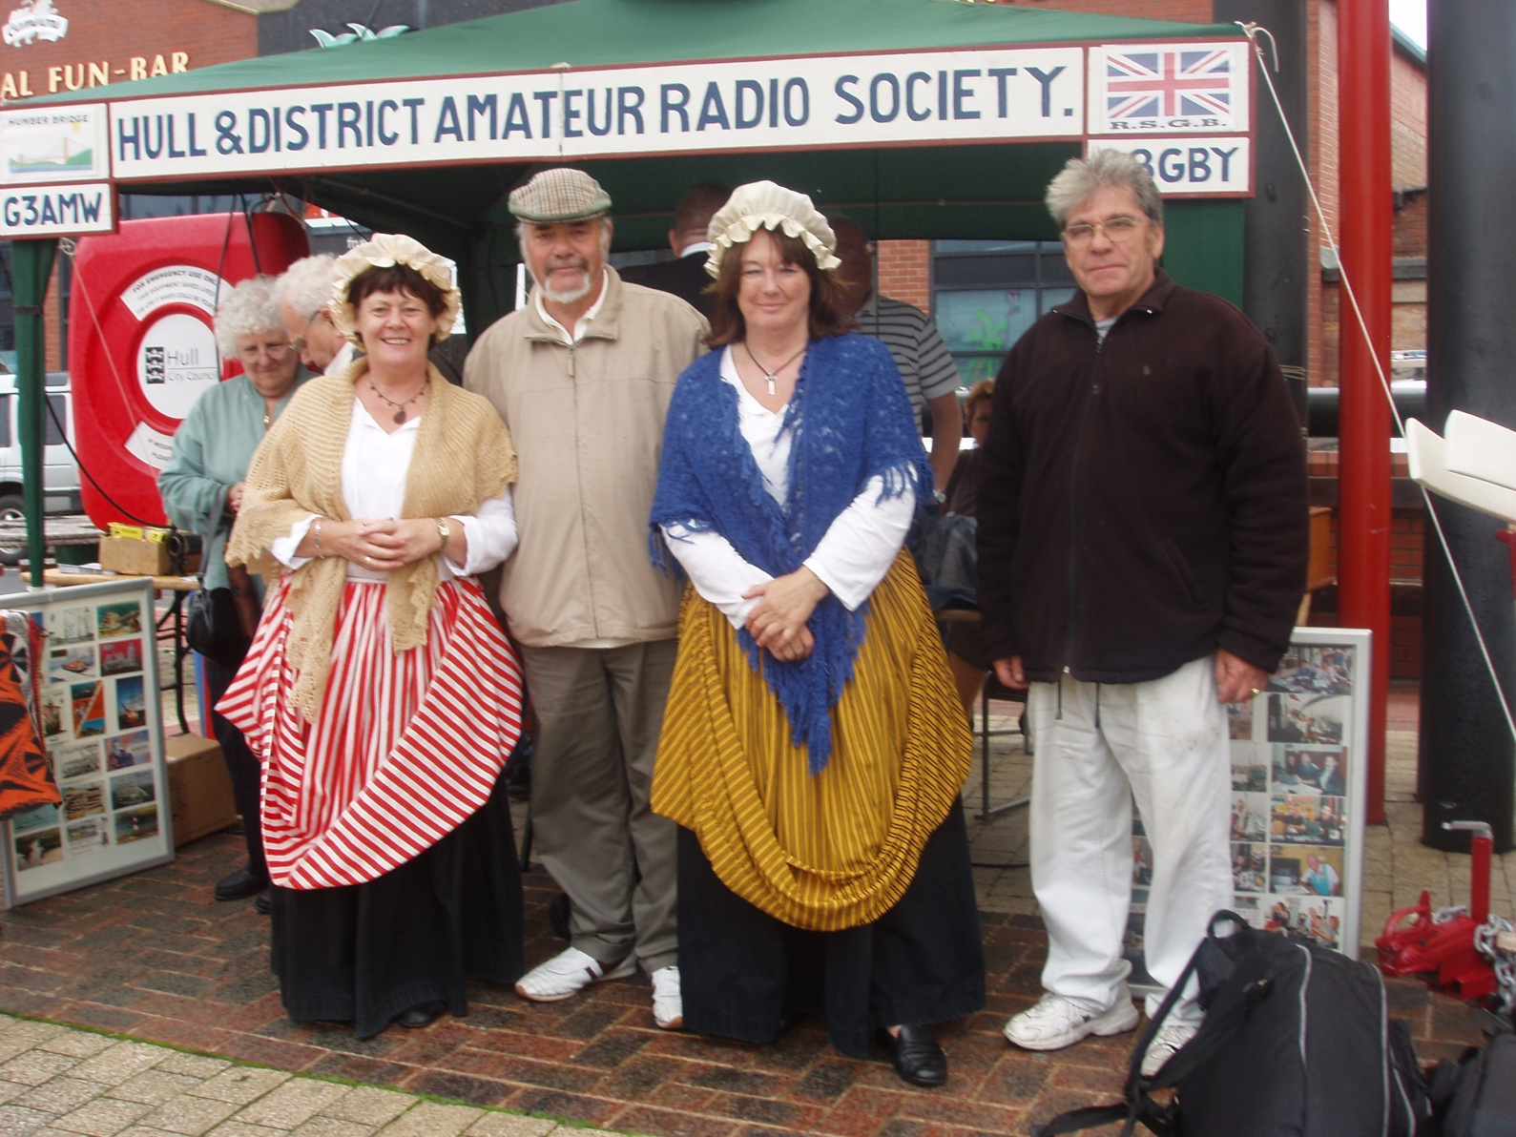
History of HADARS: September 2006

Slide 43
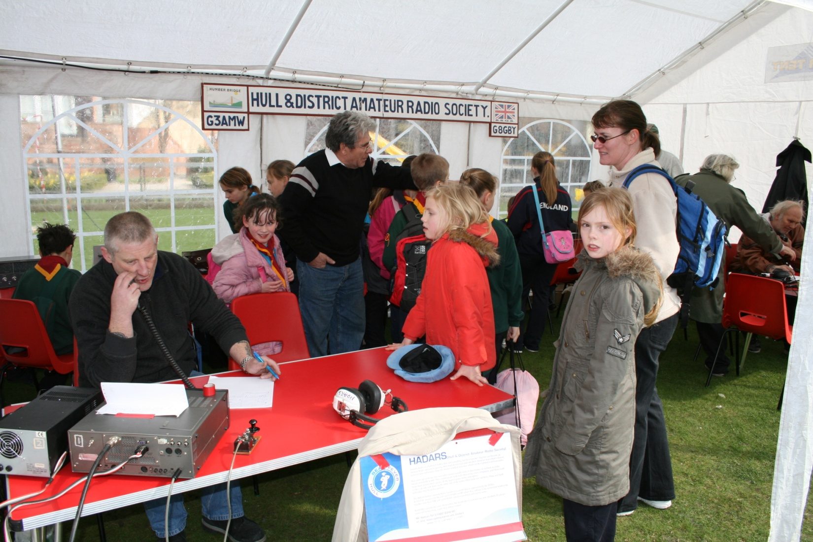
History of HADARS: March 2007

Slide 44
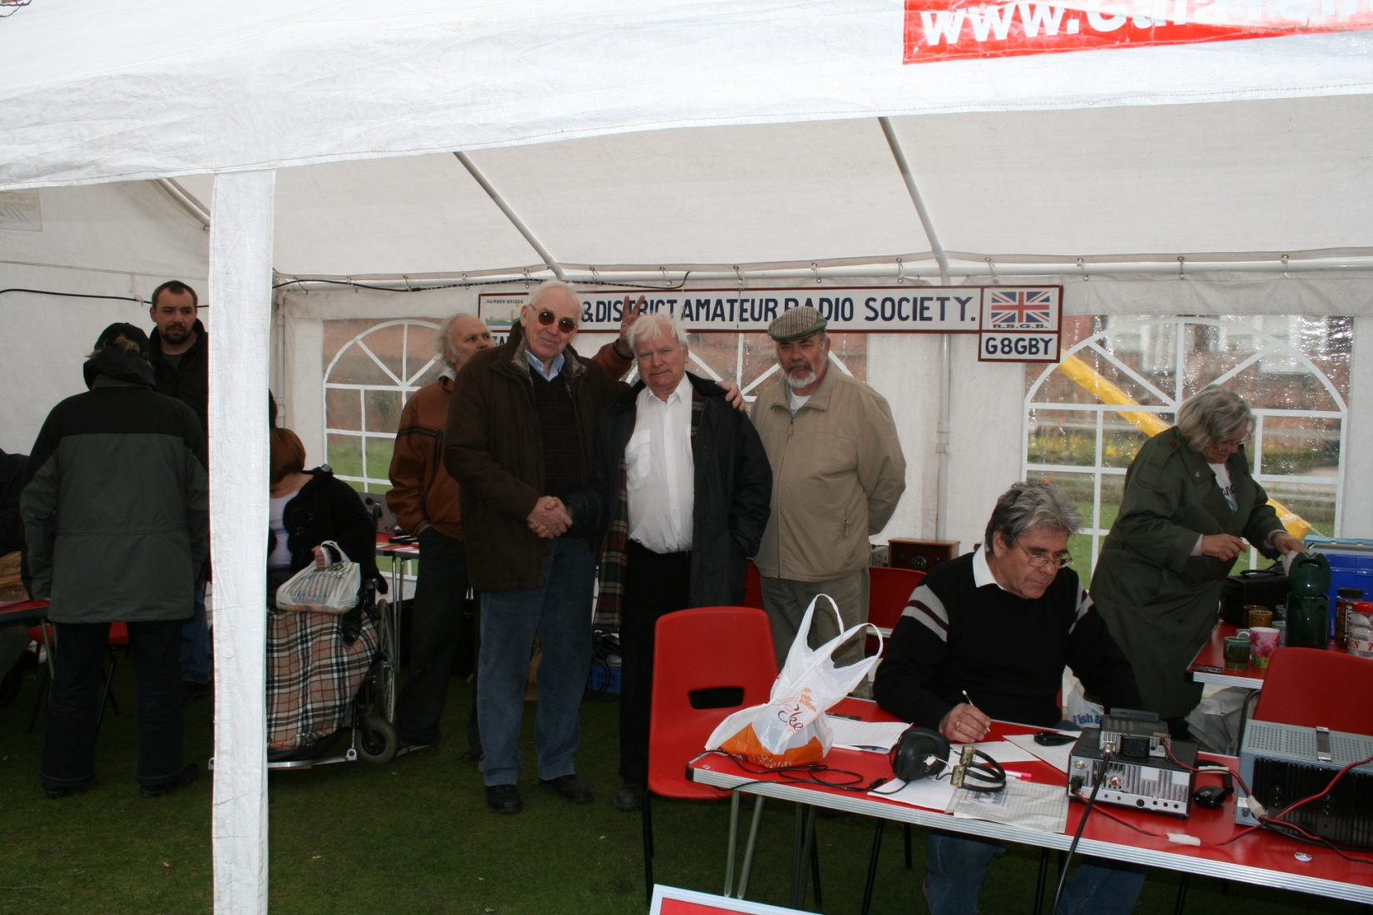
History of HADARS: March 2007

Slide 45
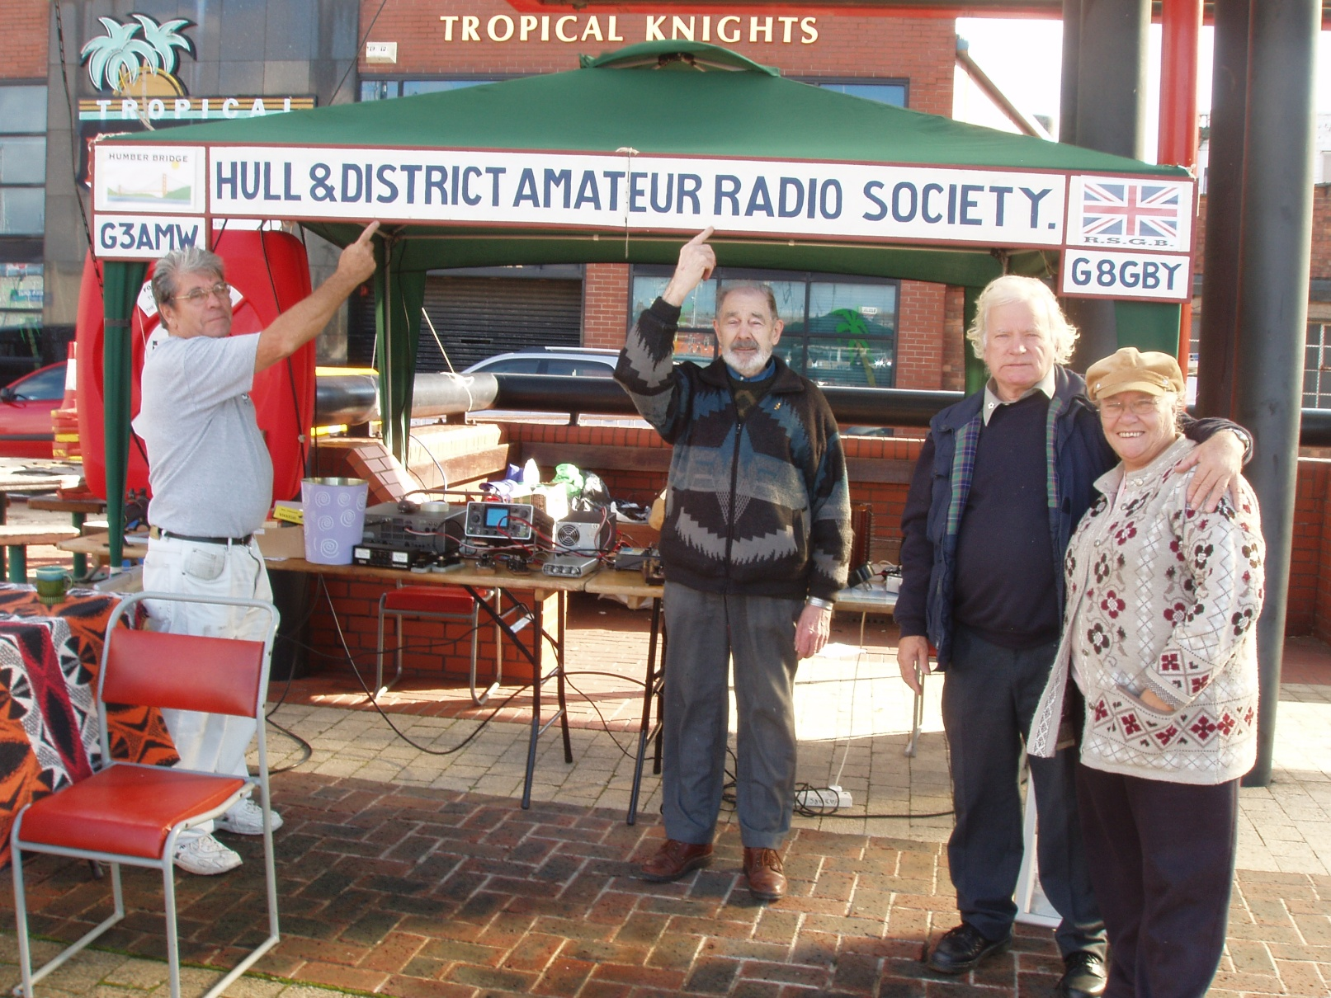
History of HADARS: September 2007

Slide 46
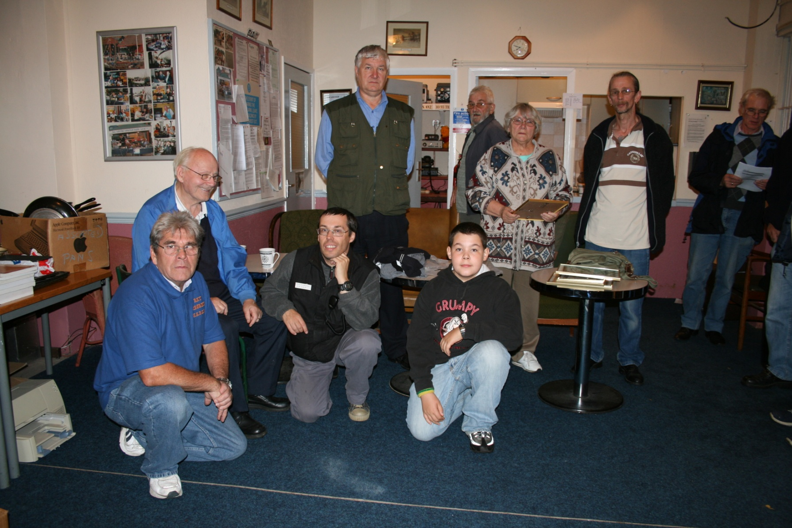
History of HADARS: September 2007

Slide 47
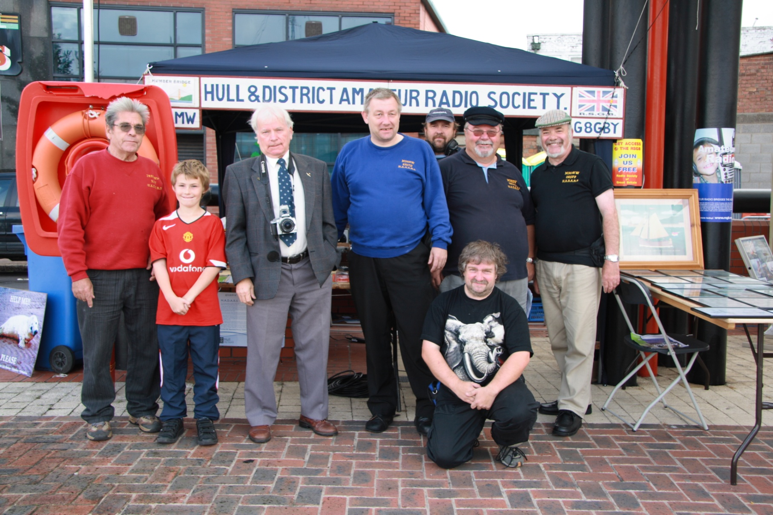
History of HADARS: September 2008

Slide 48
History of HADARS
Honorary Secretaries
Years | Name | Callsign
November 1947 | Bell | G2XA
May 1950 | G.L. Fish | G3ADJ
February 1951 – July 1953 | J.R. Borrill | G3FKK
March 1954 | R.C. Parnaby | G2DPA
October 1955 | J. Garbutt
July 1956 | M.P. Squance | G3HTB
May 1958 | Alan Beautement | G2CNX
April 1958 – December 1961 | G.G. Wray | G3MVO
March 1962 | D. Cocking | G3OMO

Slide 49
History of HADARS
Honorary Secretaries
Years | Name | Callsign
March 1963 | B.W. Woodfield | G3REL
September 1963 | W.H. Hall | G3RMX
March 1965 – November 1965 | Tony Sherer | G3TEU
September 1966 – December 1966 | G.G. Wray | G3MVO
February 1967 | Dave Peacock | G3NOP
March 1968 – April 1973 | Mary Longson
May 1973 – March 1974 | F. Moss | G8GDD
November 1974 – May 1975 | J. Lawrence | G3PQY
September 1976 – March 1977 |  | G8IED
April 1977 – March 1978 | J. Dunnington | G3LZQ
May 1978 – September 1978 | P. Bigwood | G3WYW

Slide 50
History of HADARS
Honorary Secretaries
Years | Name | Callsign
November 1978 – May 1979 | H. Rodmell
July 1979 – January 1981 | E.A. Durrant | G8GLM
April 1981 – July 1981 | Heather Cunliffe
January 1982 – January 1983 |  | G6DUL
April 1983 – July 1984 | R.P. Varey | G6UOM
August 1984 – May 1985 | Denis Coldbeck | G6ABG
August 1985 – January 1986 |  | G4PEP
April 1986 – January 1987 | D. Potter | G0DMP
July 1987 – November 1989 | R.V. Souter | G1RVS

Slide 51
History of HADARS
Honorary Secretaries
Years | Name | Callsign
November 1999 – June 2000 | John Thompson | G0TPS
September 2000 – December 2000 | Jonathon | G7DBL
June 2001 – July 2002 | Leigh Duffil | G0UBY
 | Bob Hatton | G0VVP
 | John Knowles | G0KWE
 | Keith Shaw | M3SHW
 | Brian Penn | M3EOV
2011 - Present | Julian Randall | M6JMR

Slide 52
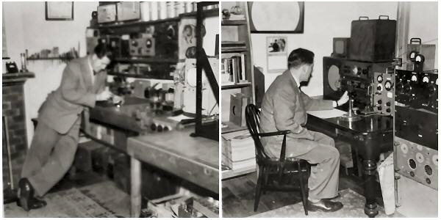
History of HADARS: Honorary Secretaries
Alan Beautemont c1950

Slide 53
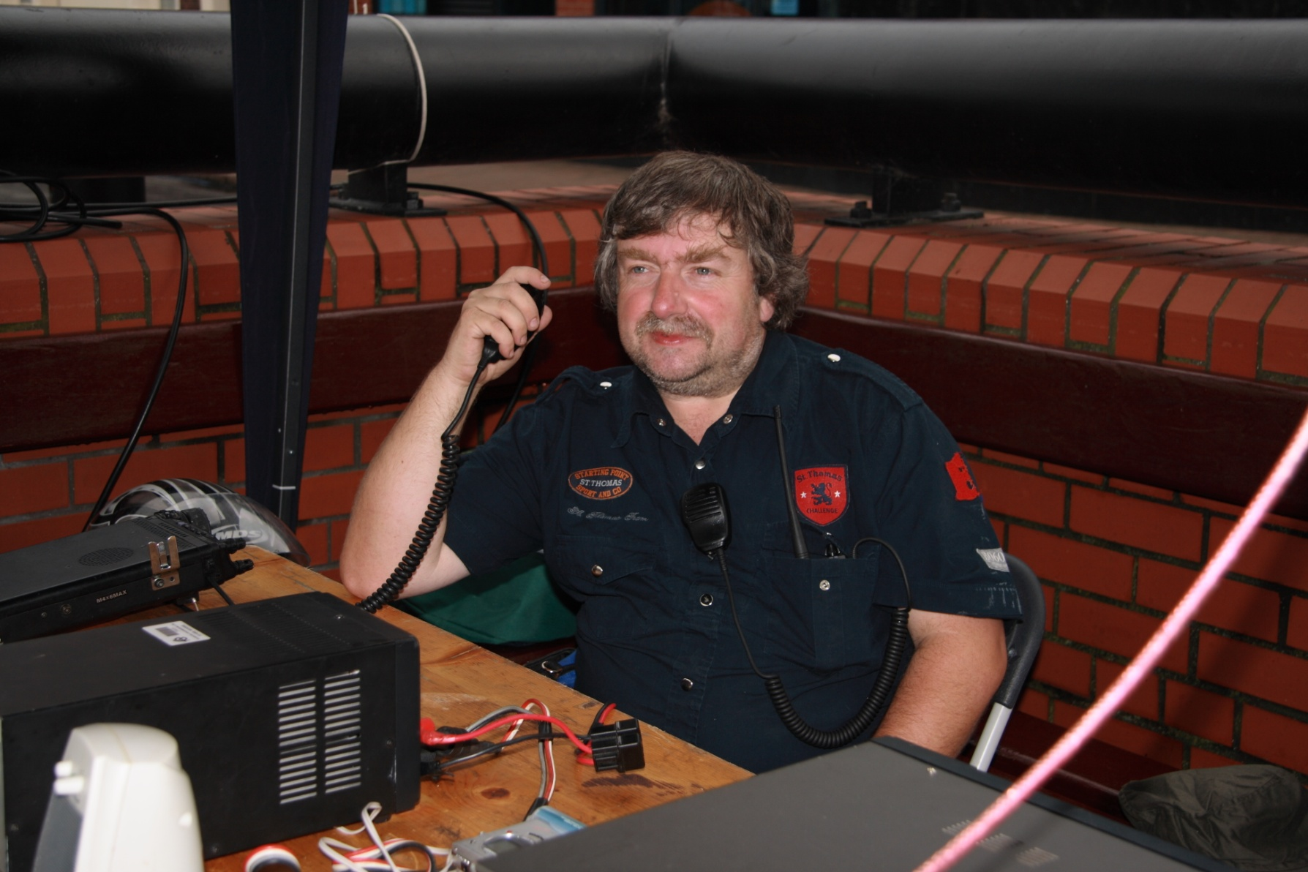
History of HADARS: Honorary Secretaries
Julian Randall

Slide 54
History of HADARS
Summary
1921: Radio Society of Hull & District affiliated to Wireless Society of London
1932: New group formed in Hull
1934: Hull Short Wave Club formed
1939: Short Wave Club for Hull & District formed
1939 - 1945: No group/club activities in Hull
1952: HADARS formed & affiliated to the RSGB

Slide 55
History of Amateur Radio in the East Riding Future Research
At least 1 more visit to the National Radio Centre
Get more scanned copies of Bulletins/RadComs from RSGB
Get more scanned copies of SWMs from Elaine Richards
Appeal on Radio Humberside for information
Appeal in RadCom for information

Slide 56

Questions

